Slide 1
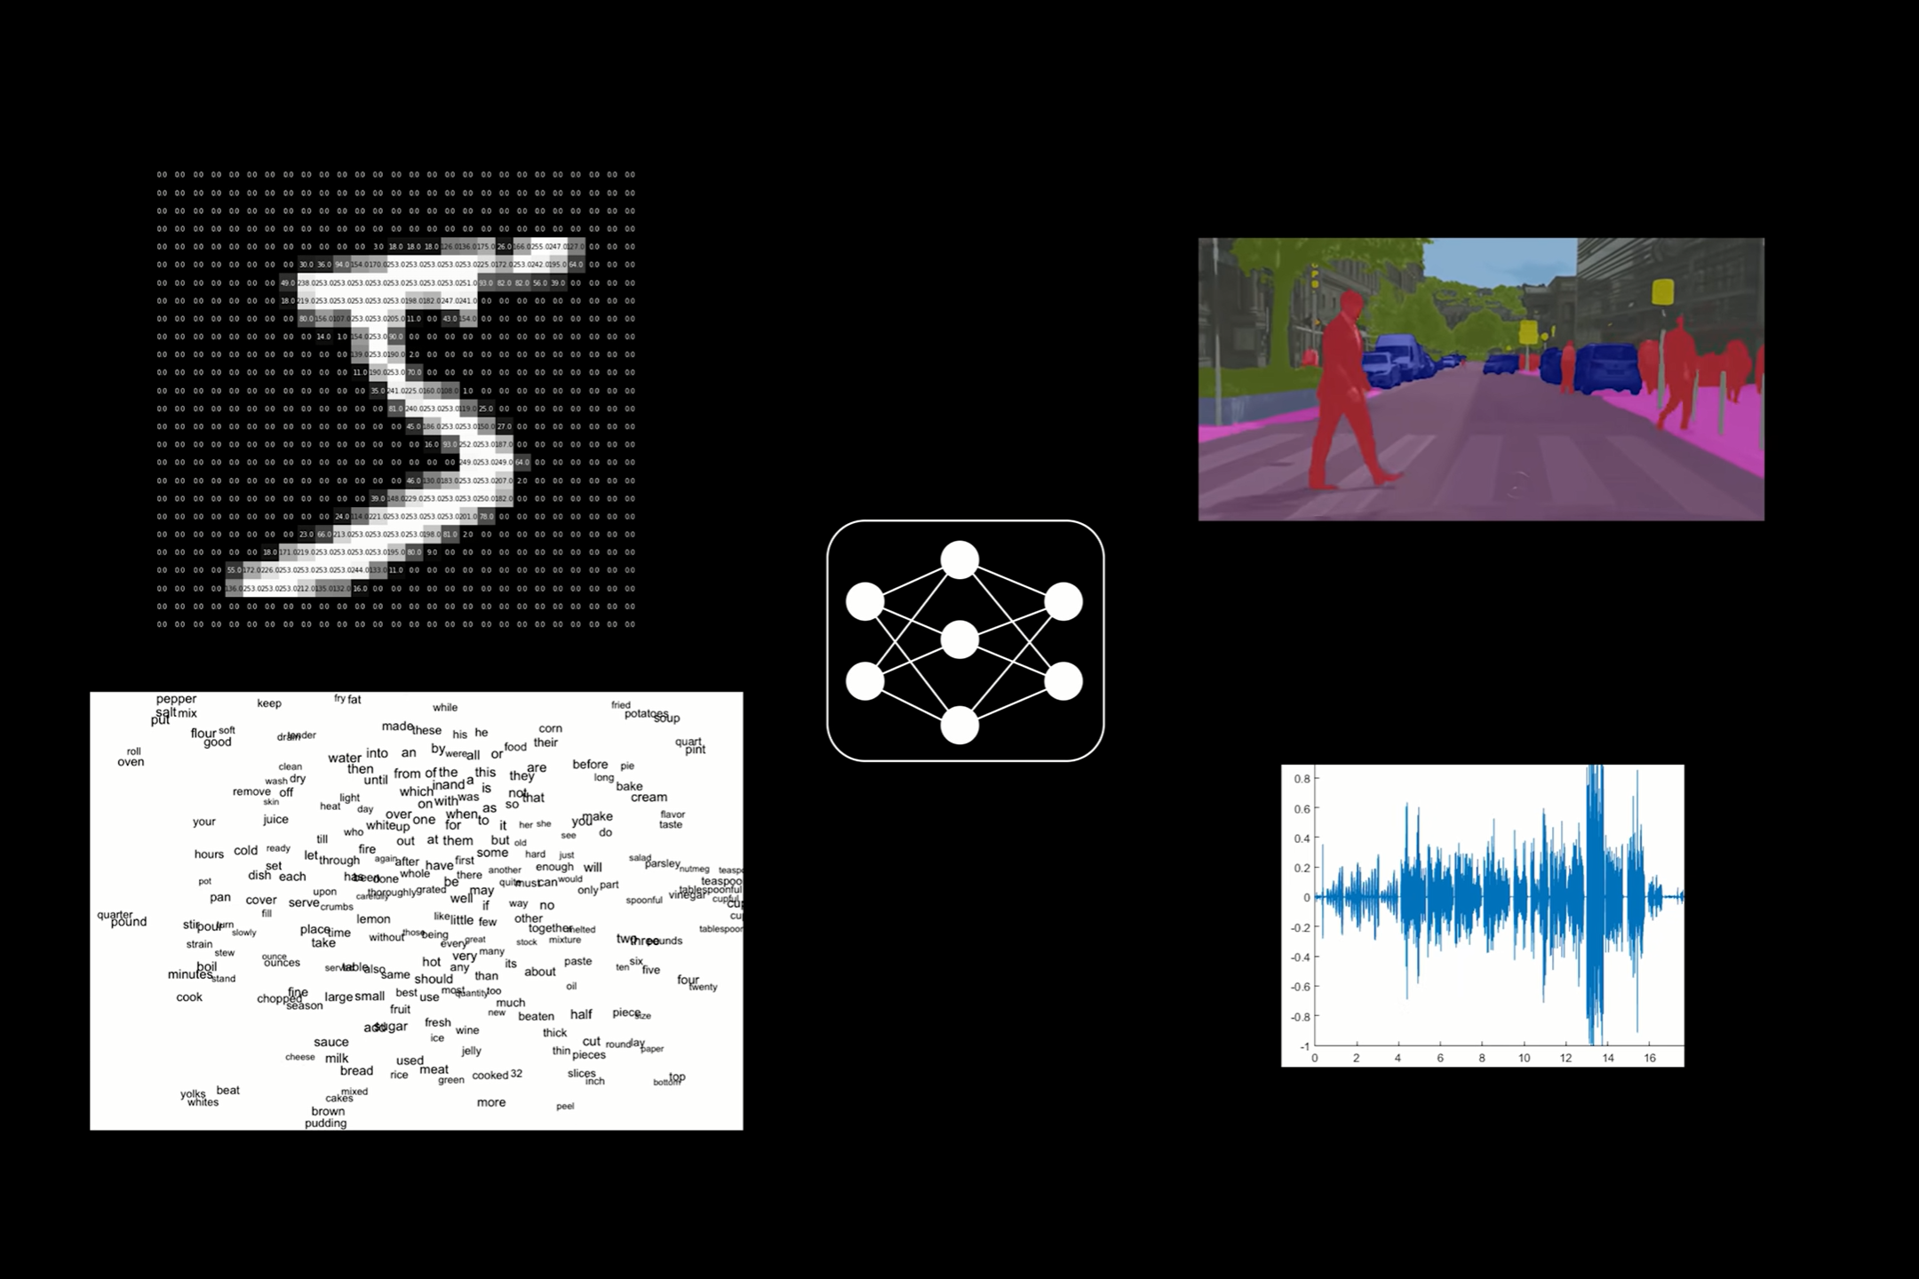
Machine Learning for Biomedical Data Deep Learning
by Fernando Carazo, PhD

Slide 2
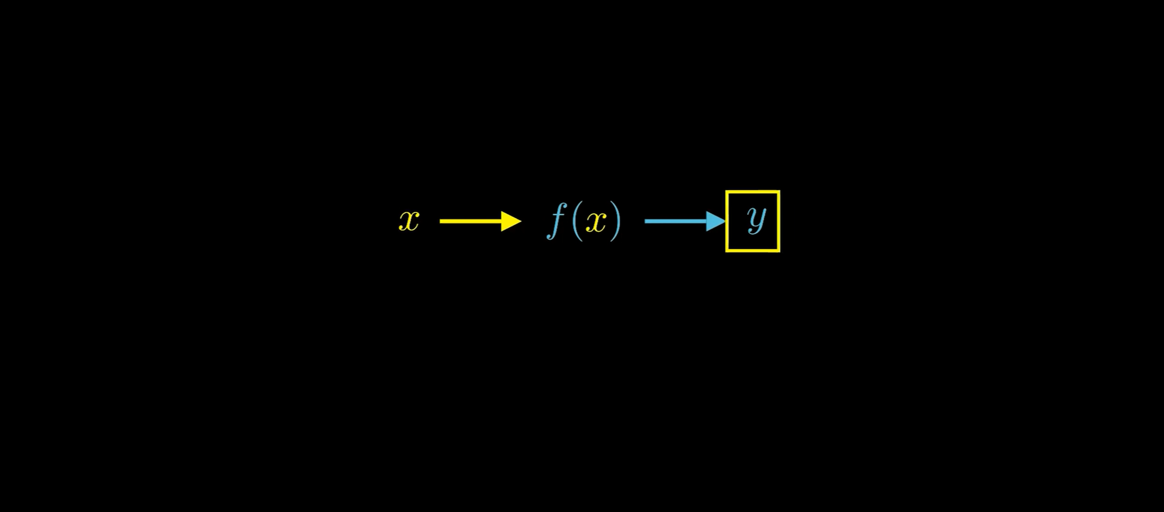

Slide 3
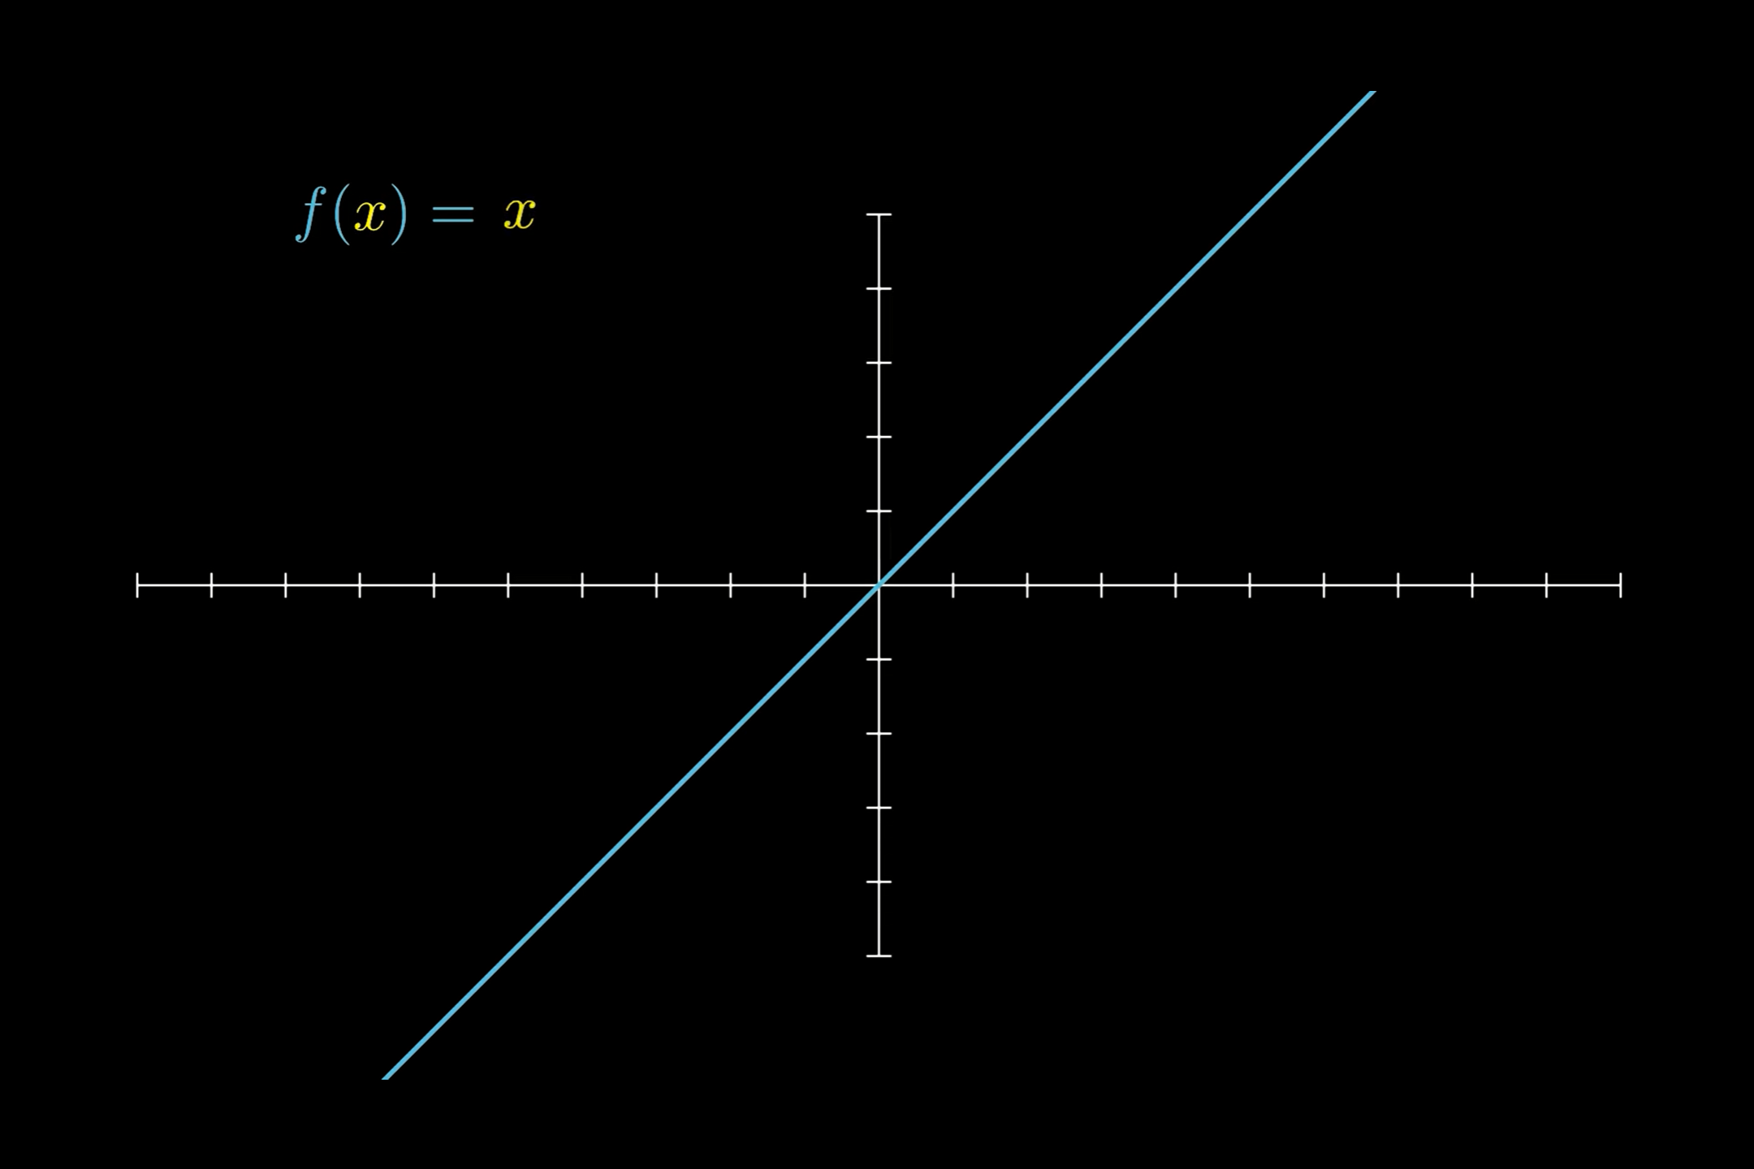

Slide 4
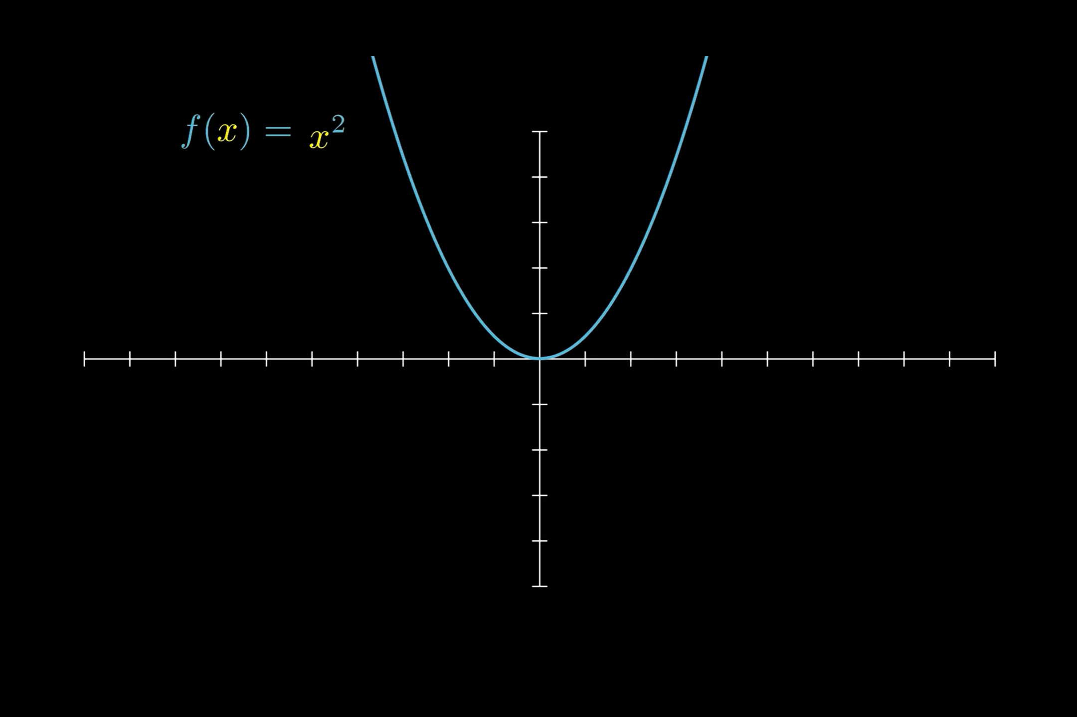

Slide 5
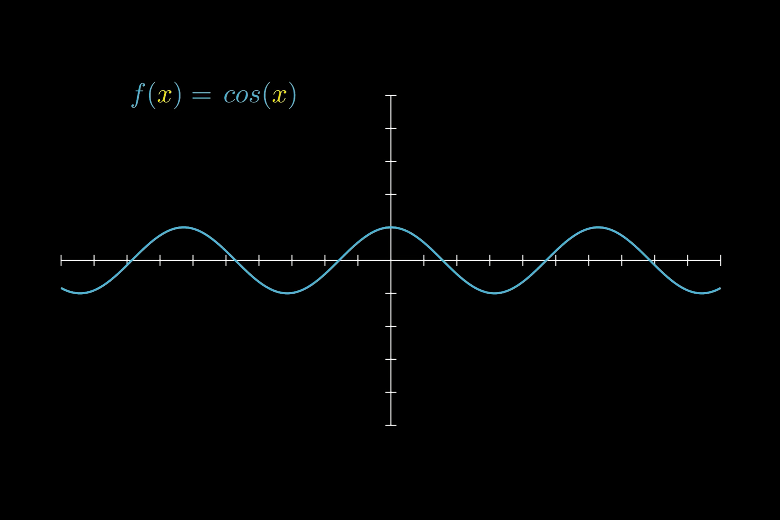

Slide 6
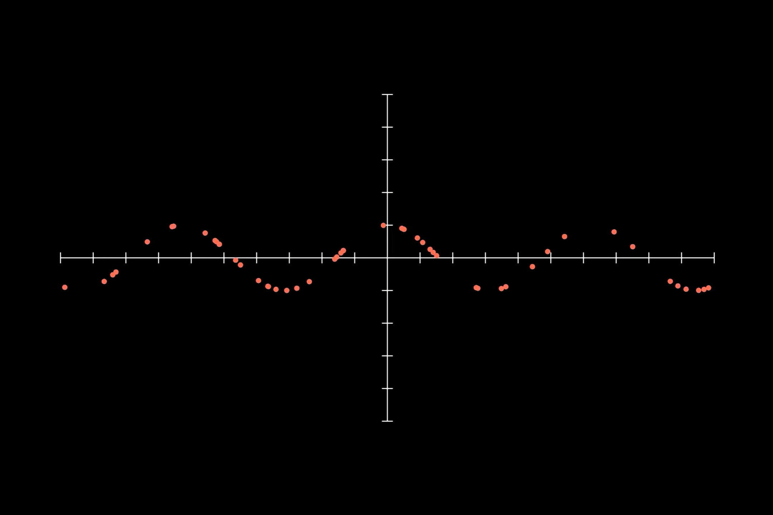

Slide 7
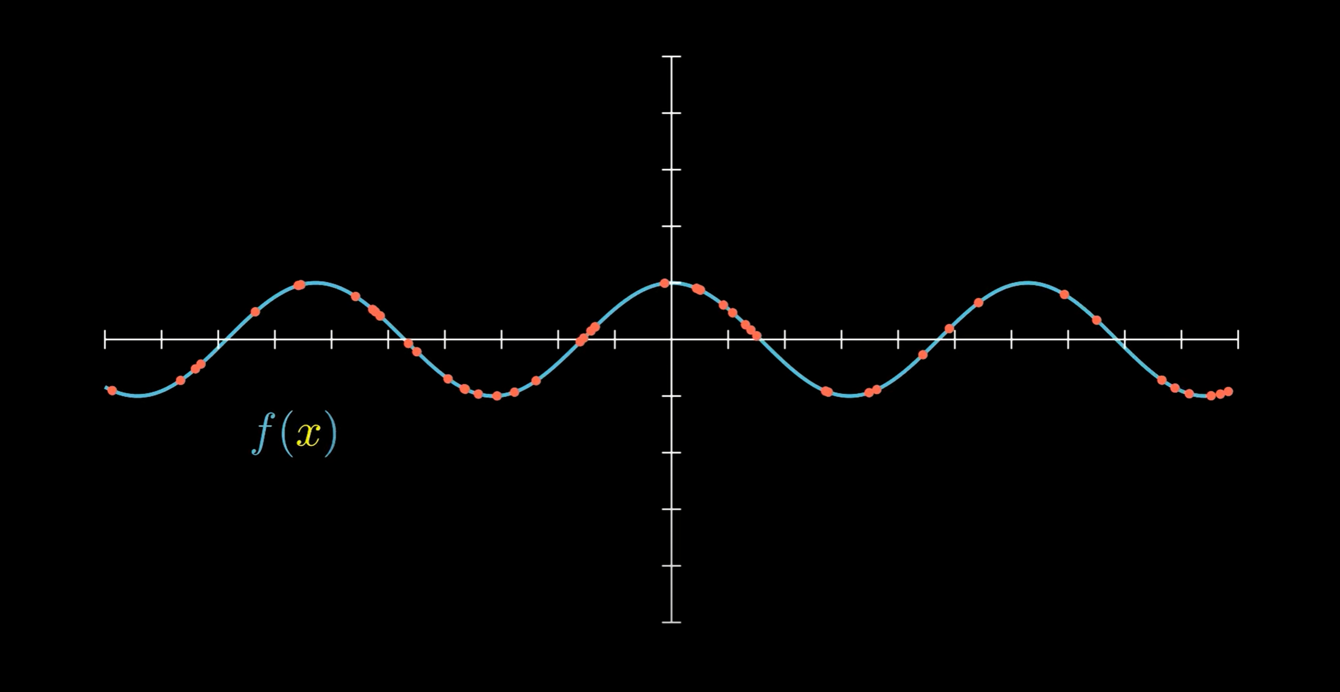

Slide 8
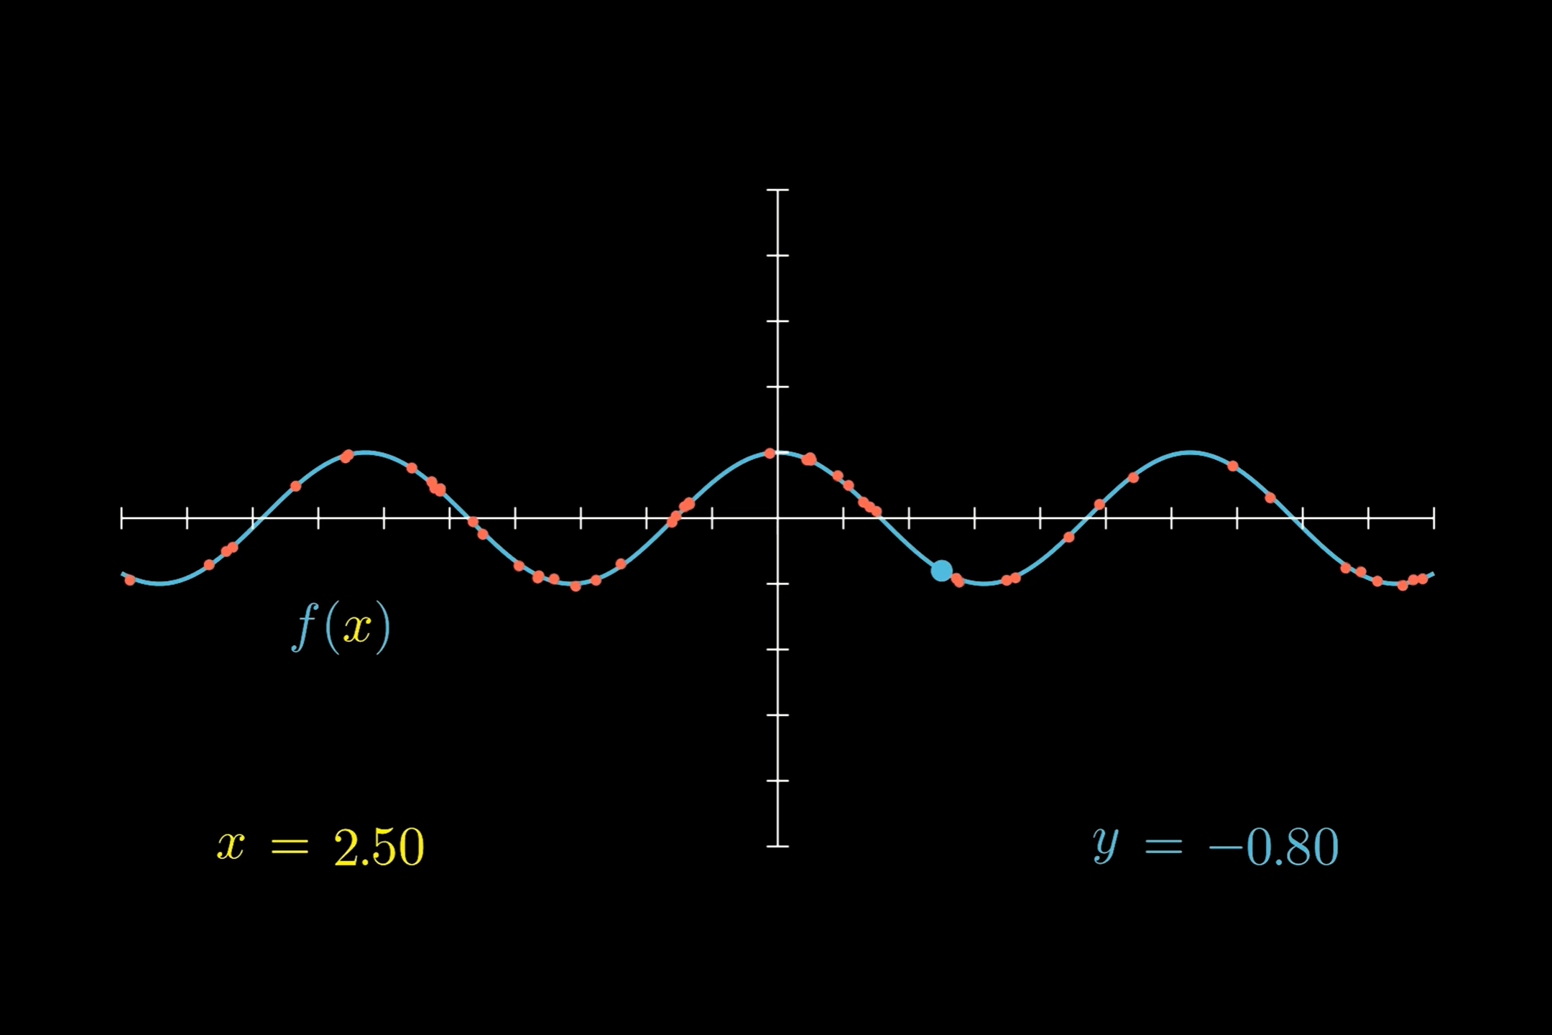

Slide 9
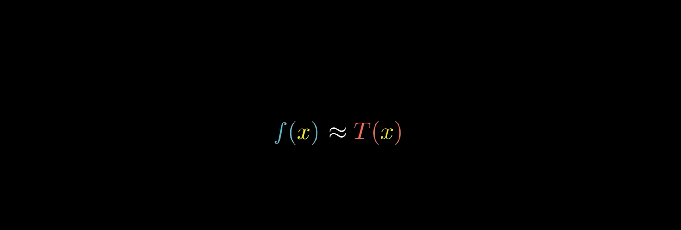

Slide 10
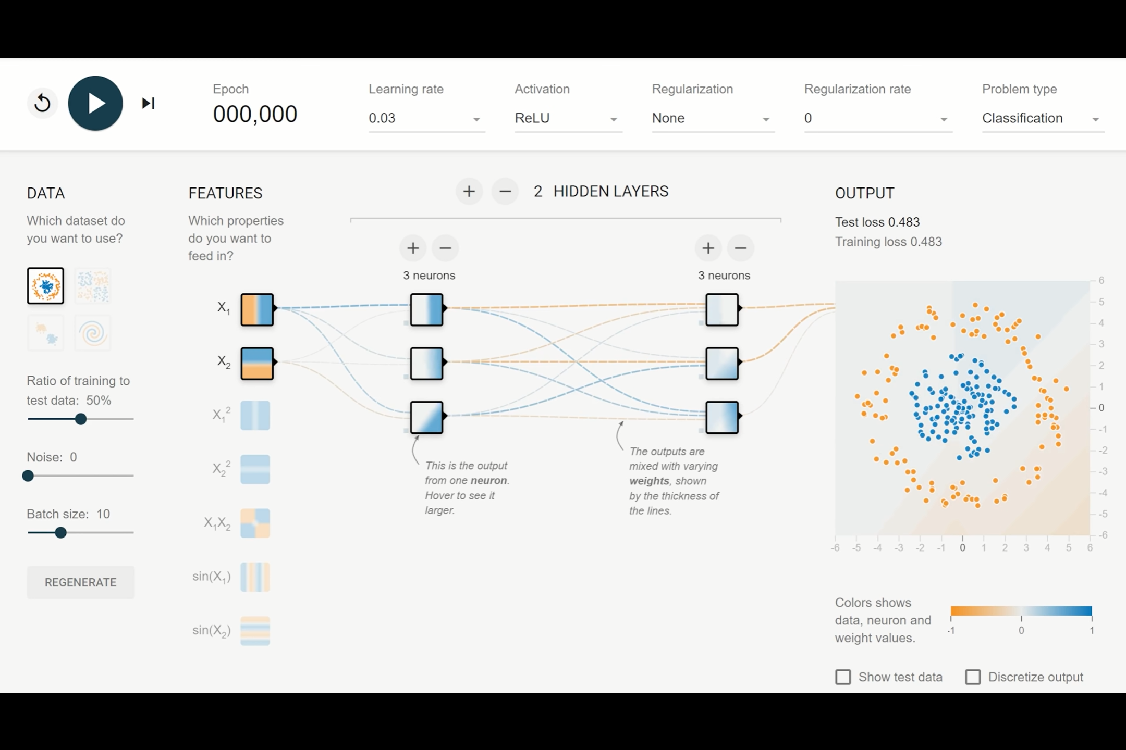
https://playground.tensorflow.org/

Slide 11
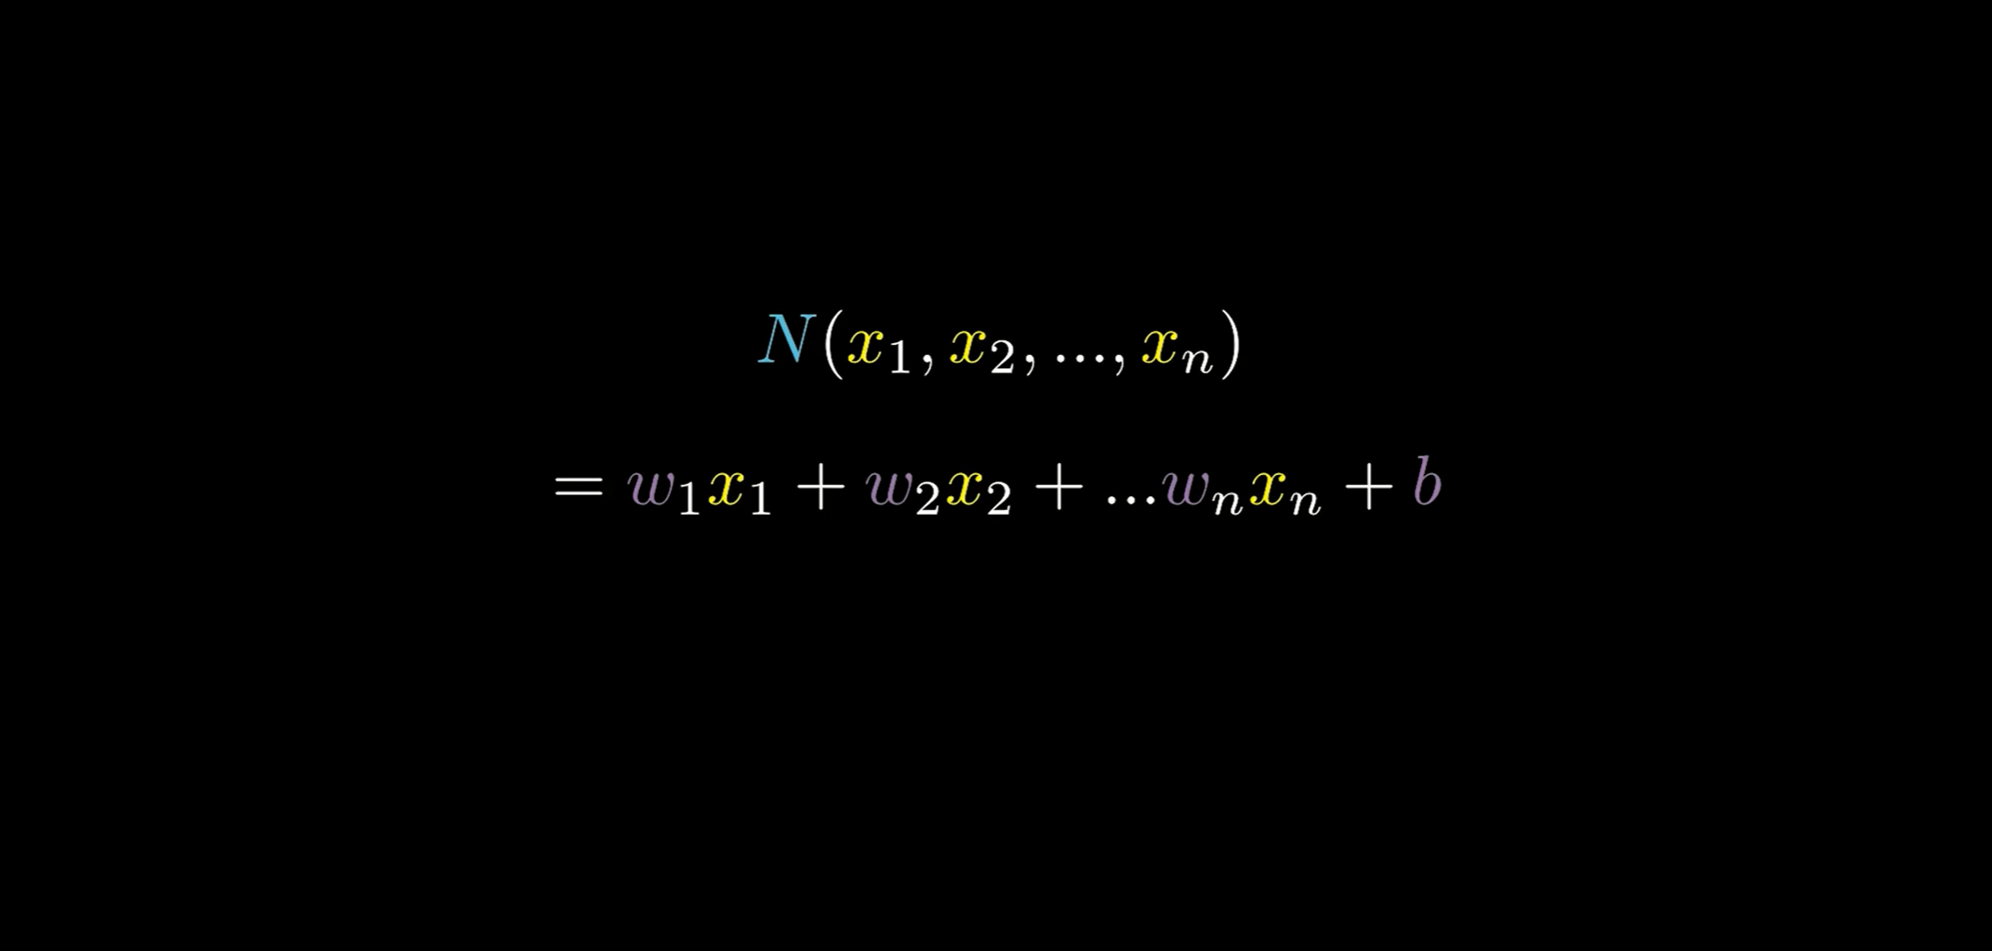

Slide 12
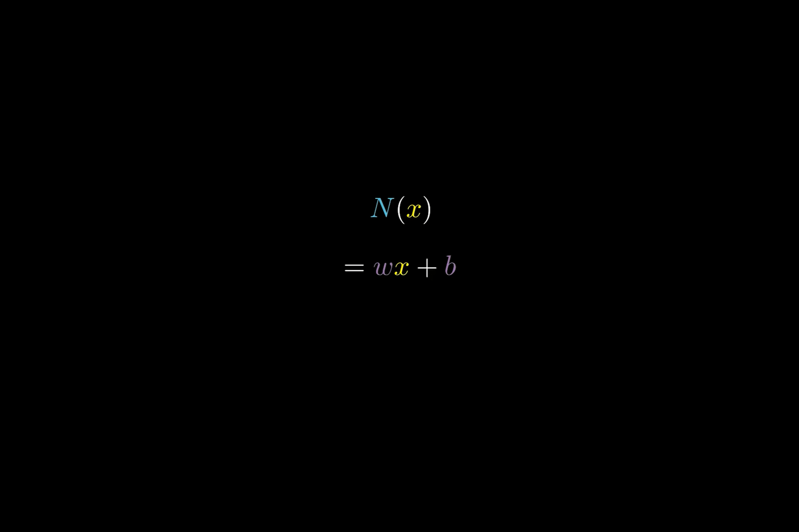

Slide 13
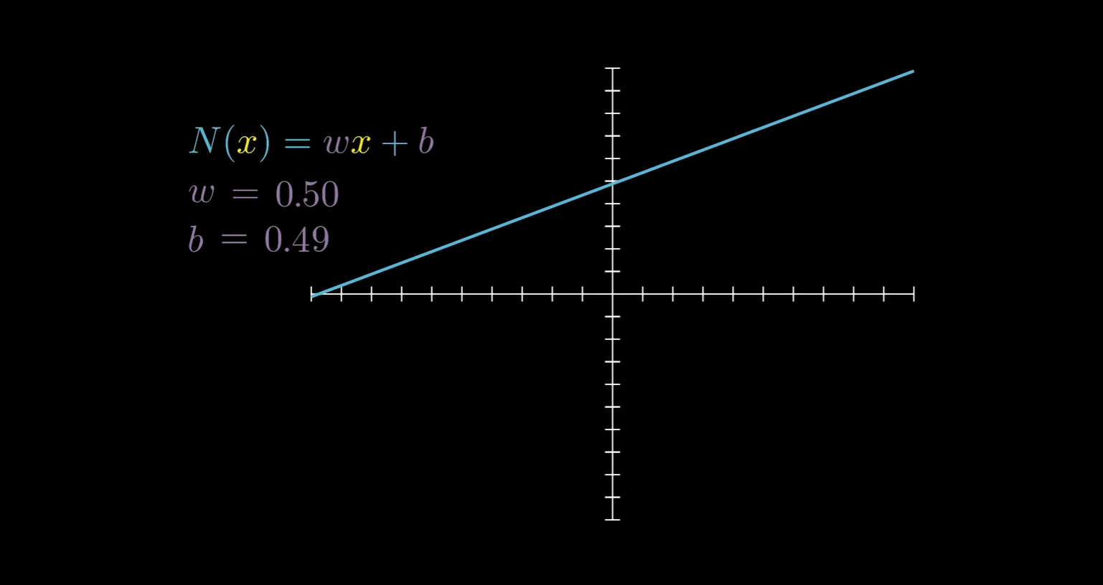

Slide 14
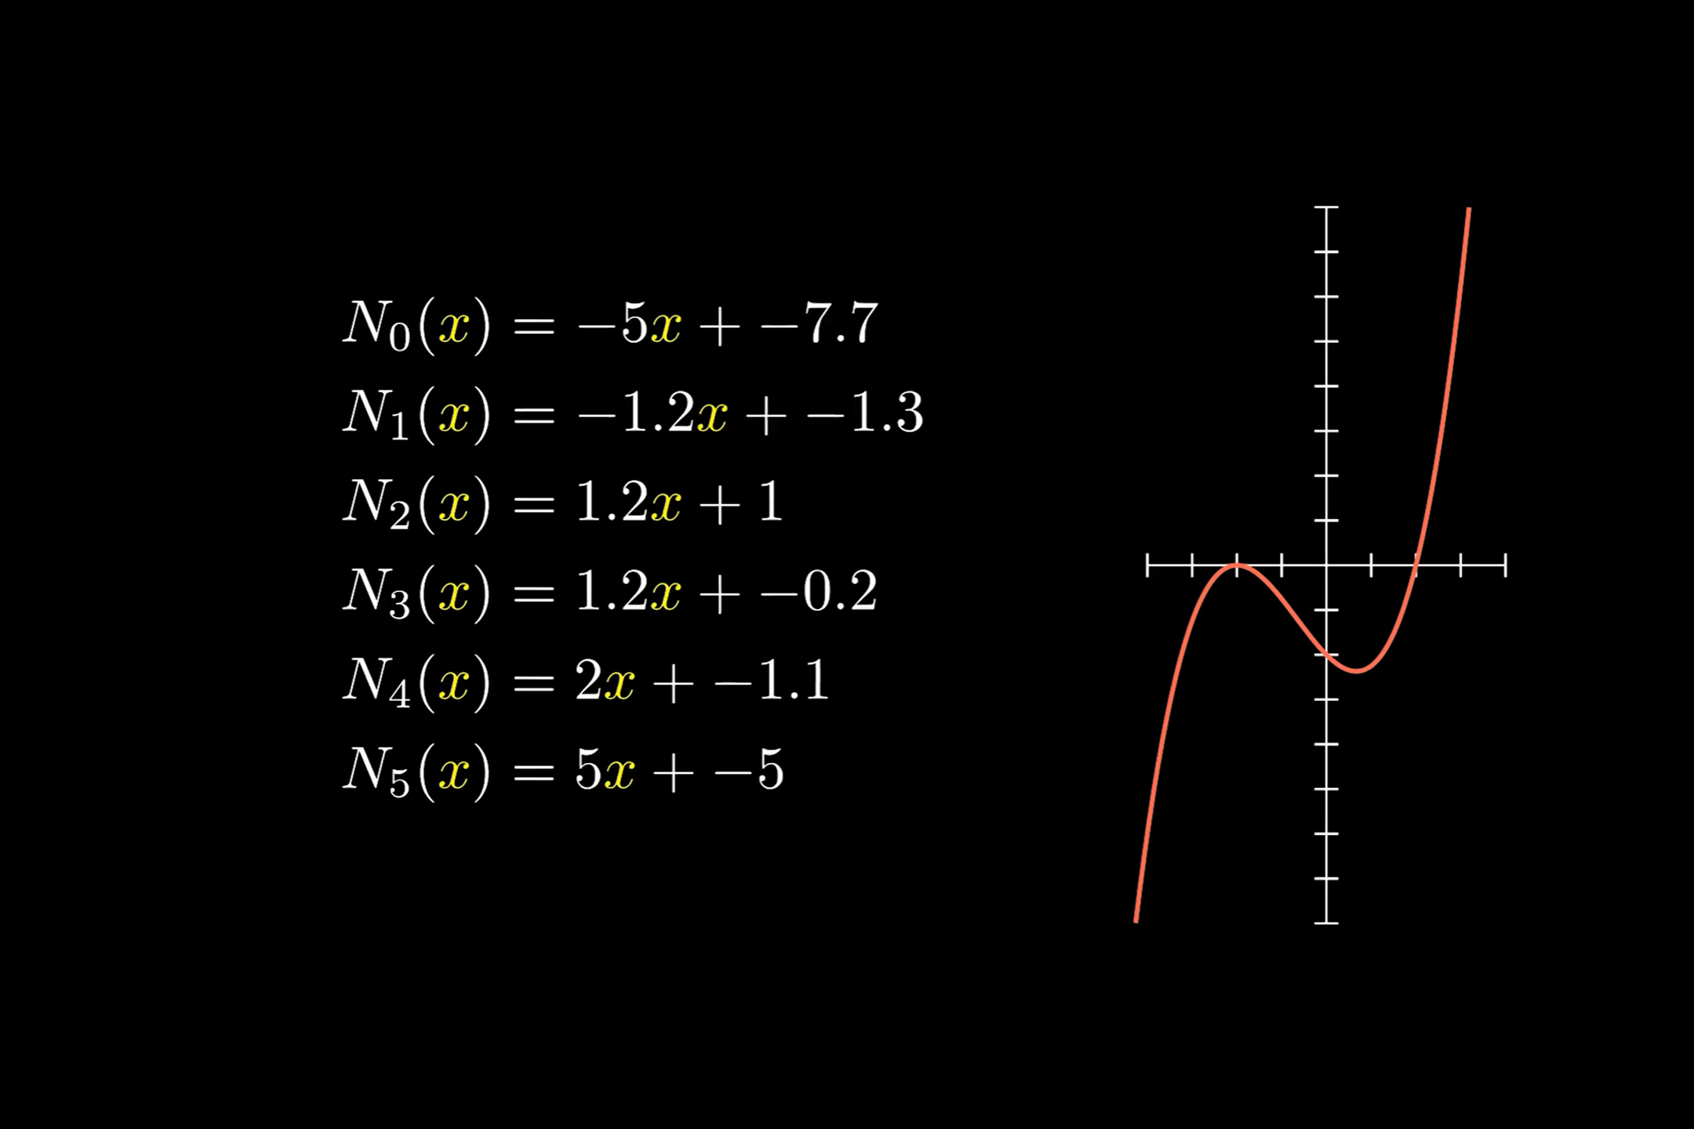

Slide 15
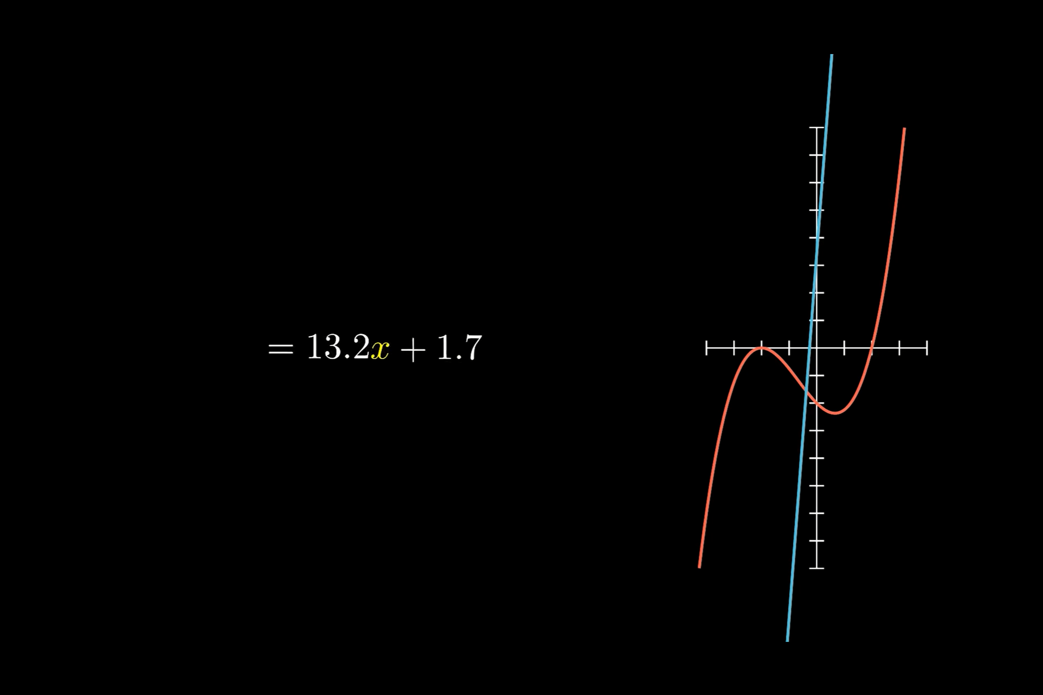

Slide 16
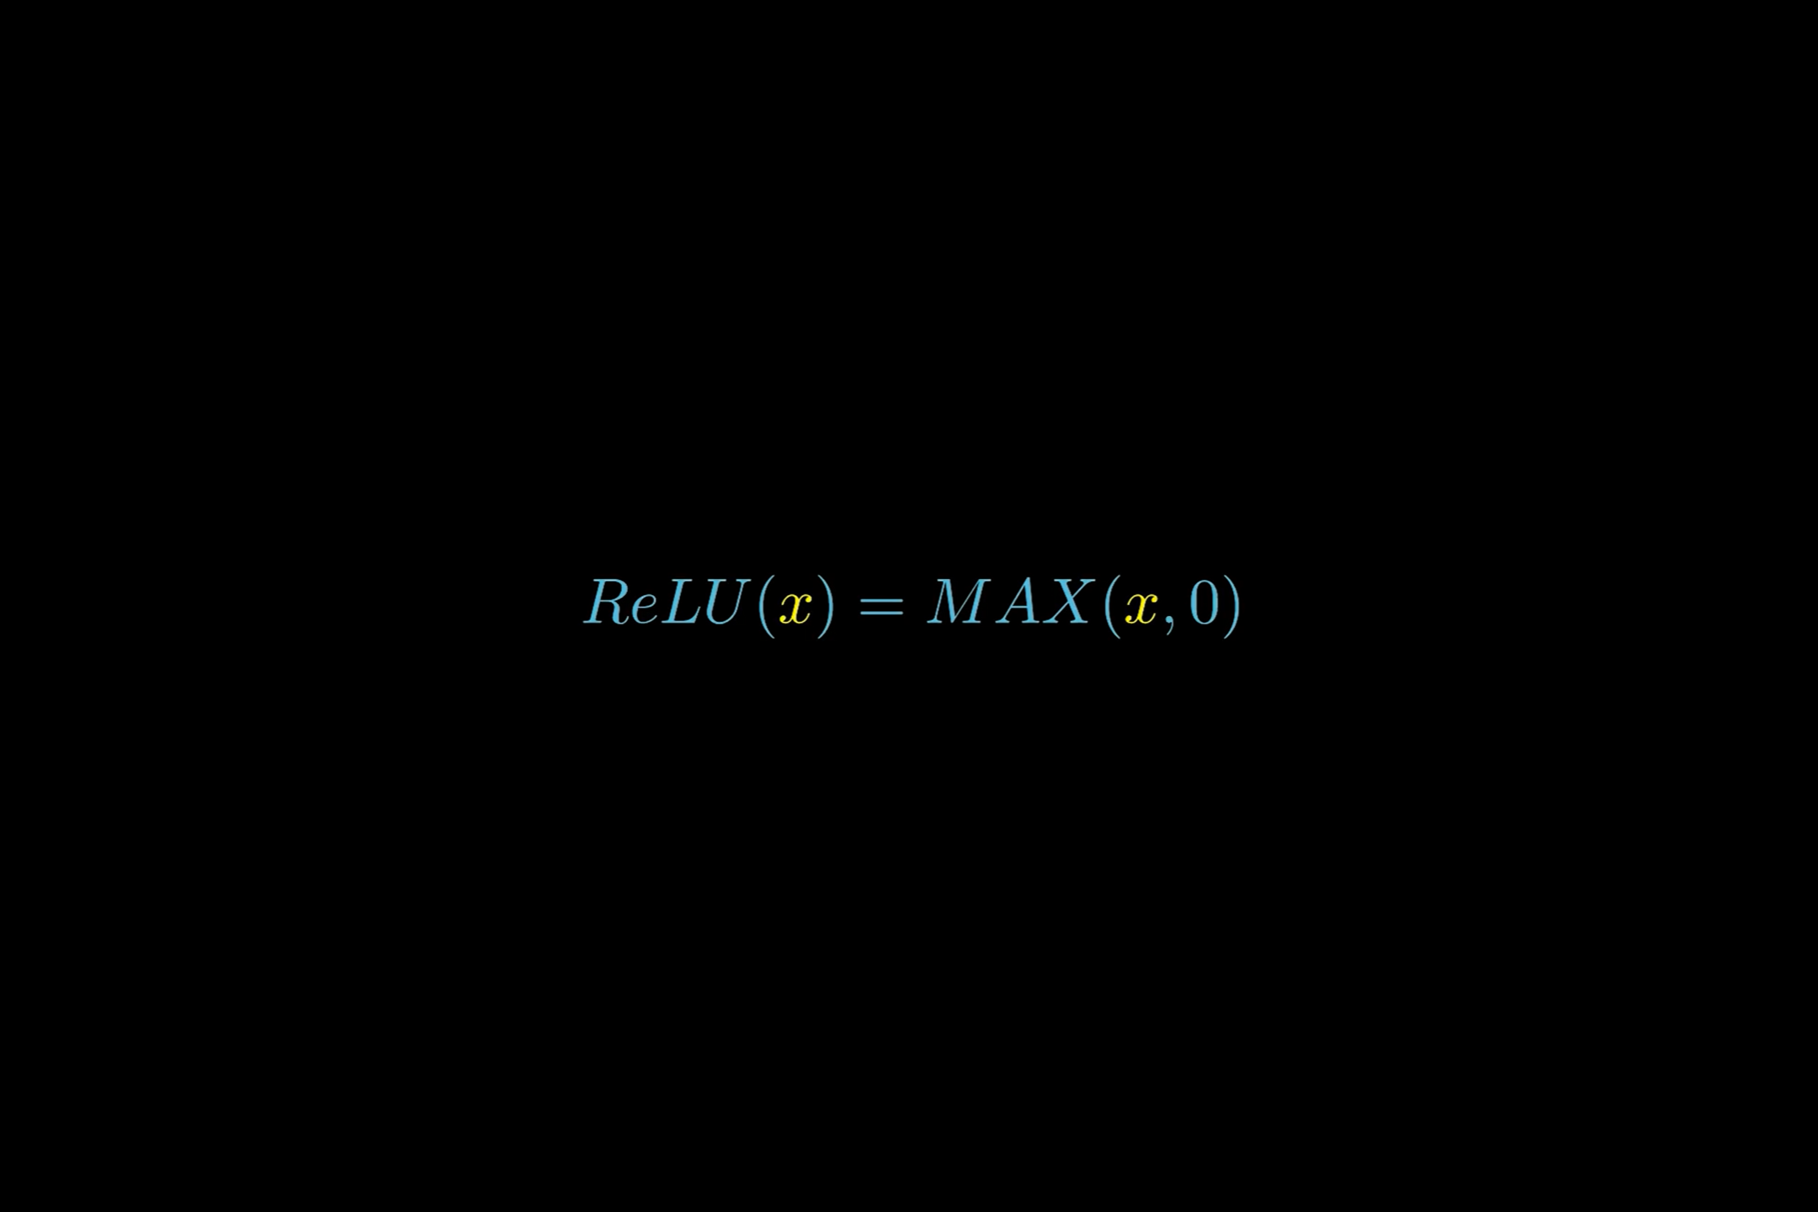

Slide 17
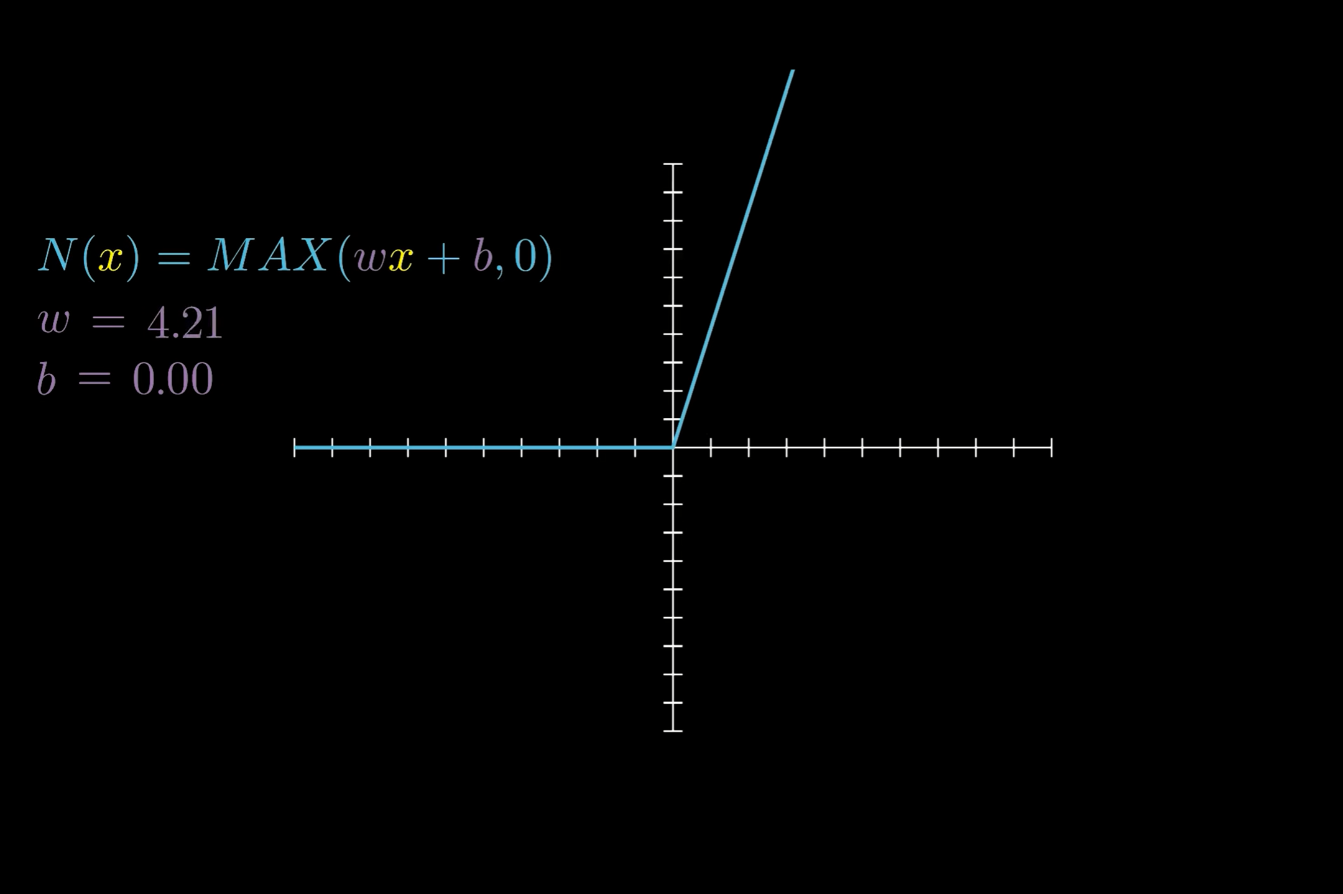

Slide 18
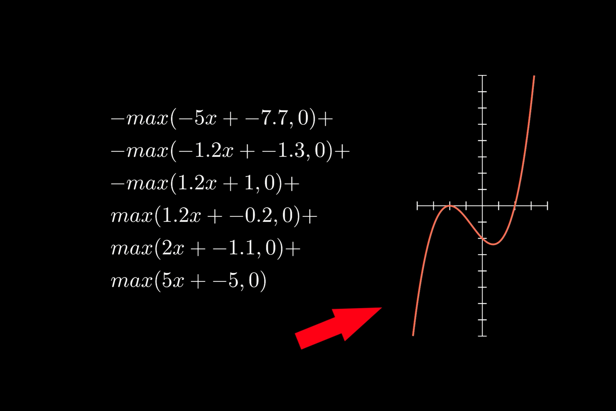

Slide 19
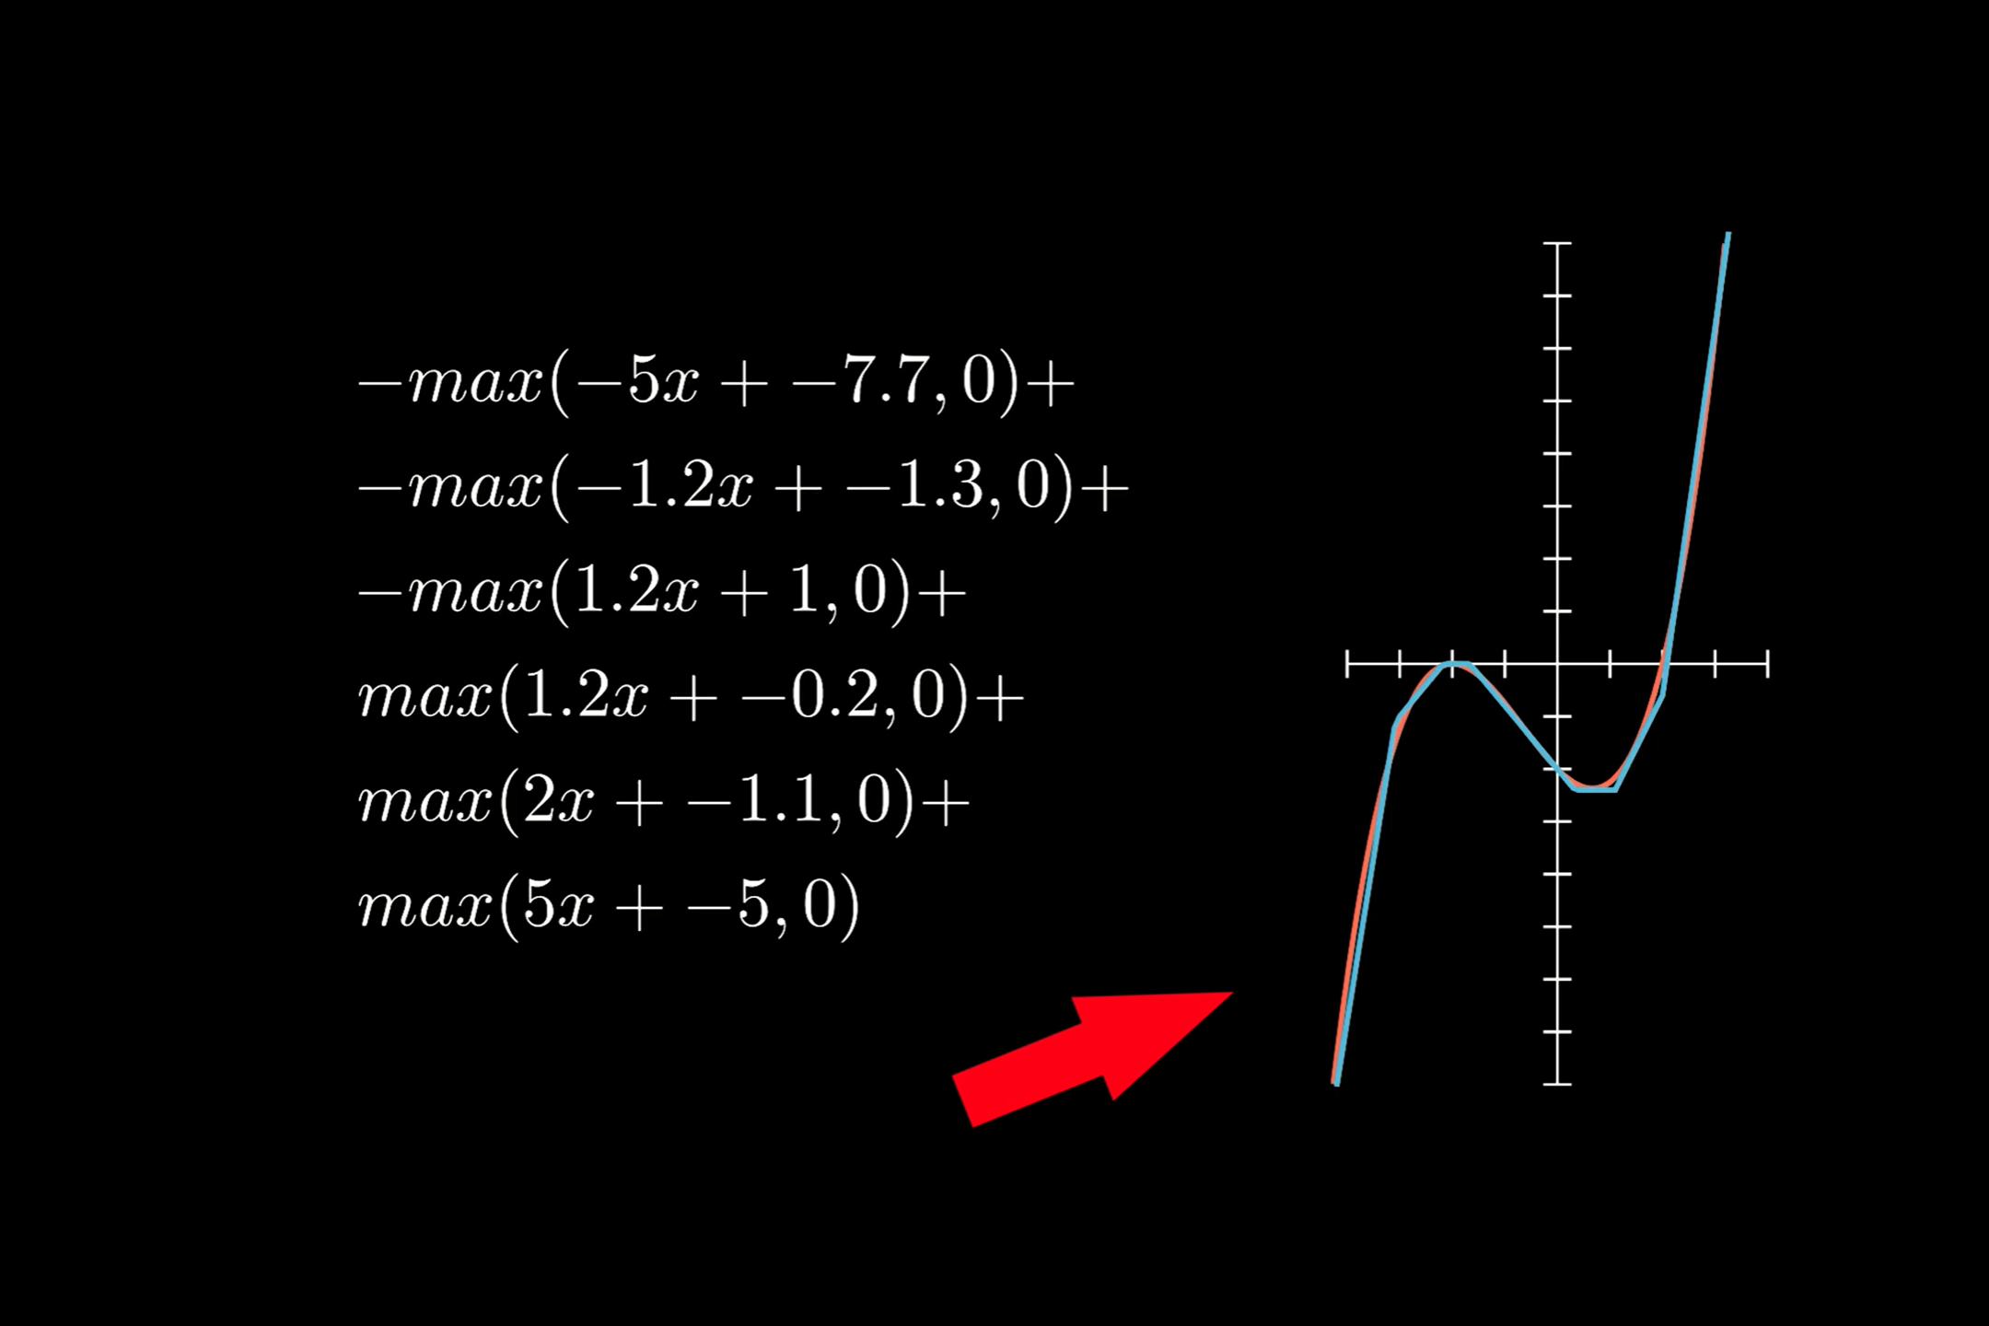

Slide 20
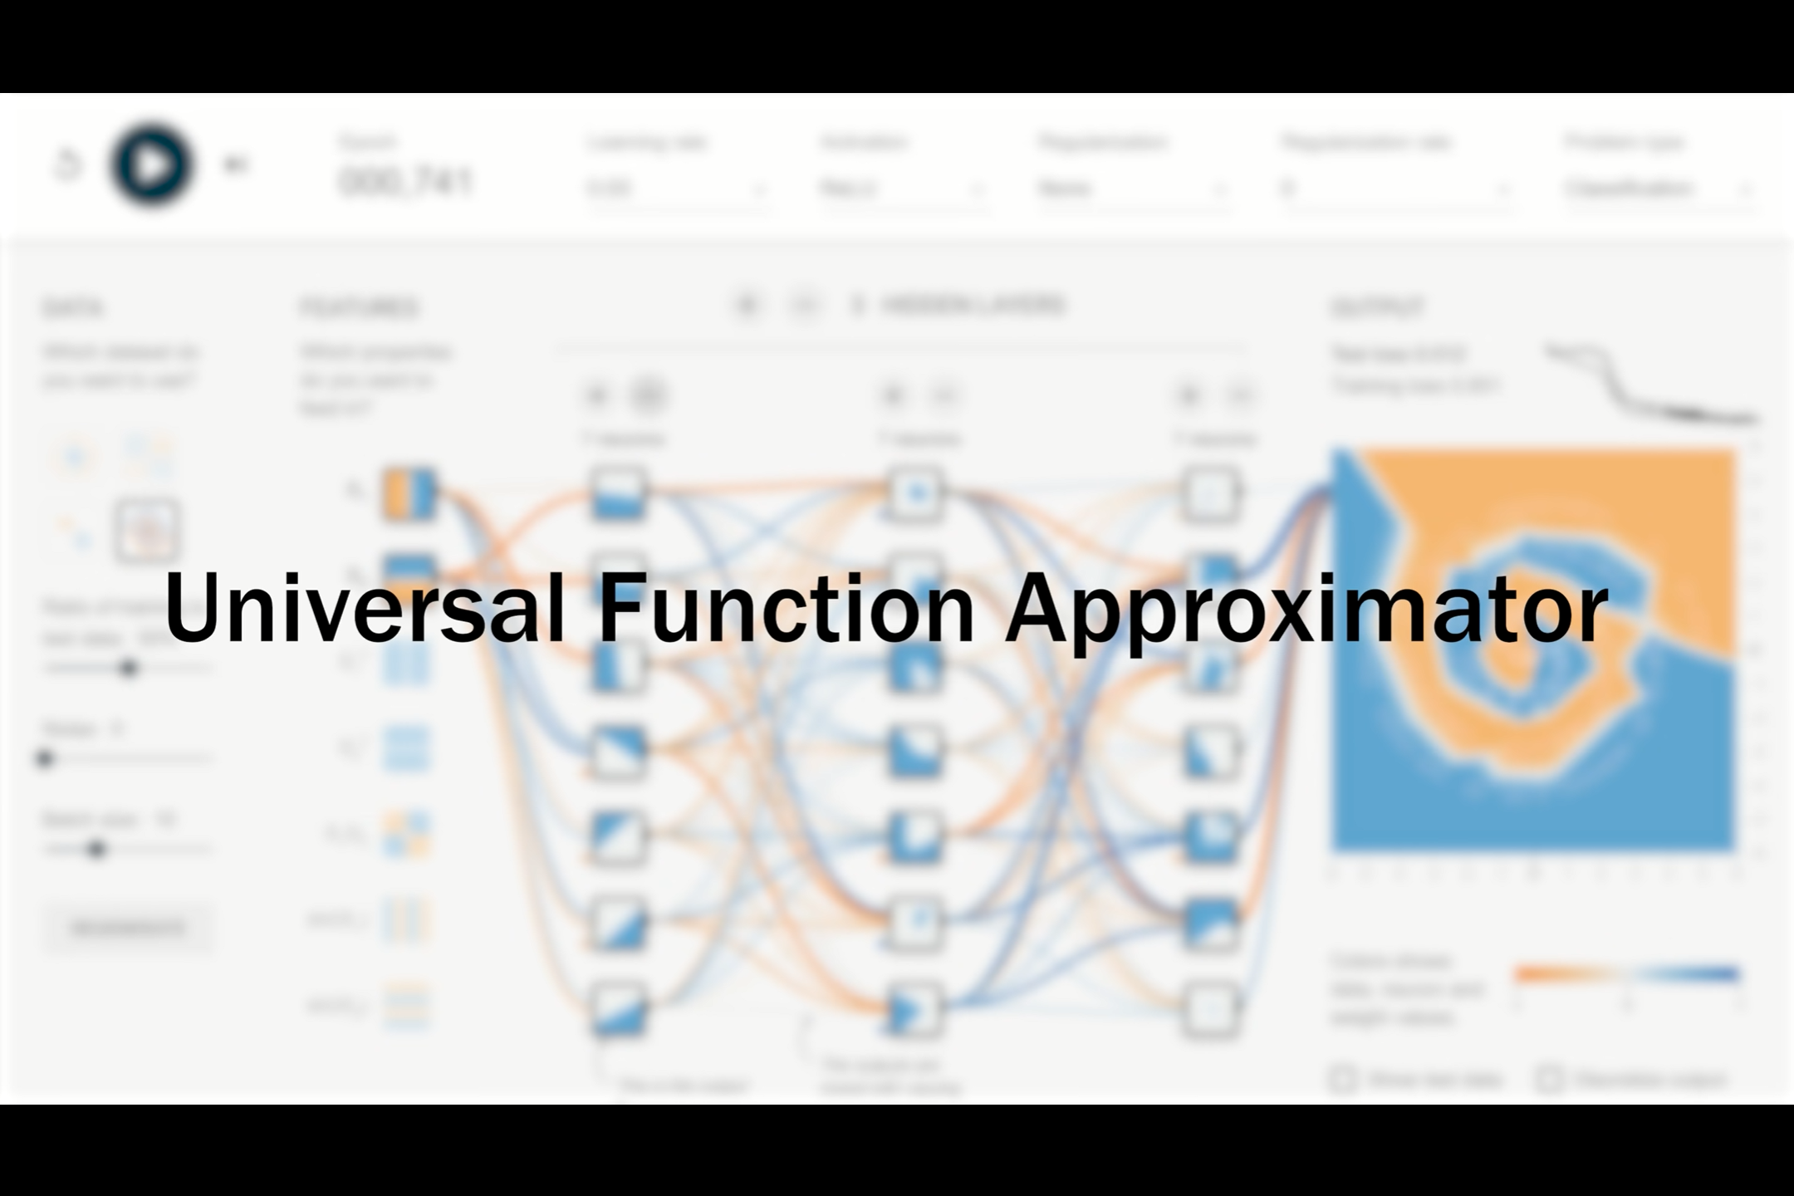

Slide 21
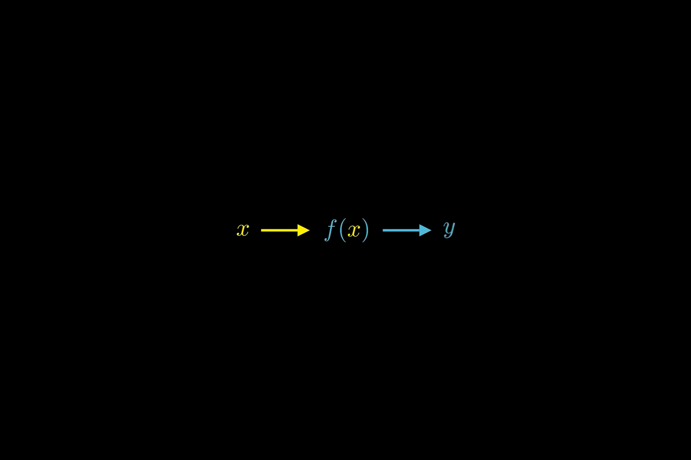

Slide 22
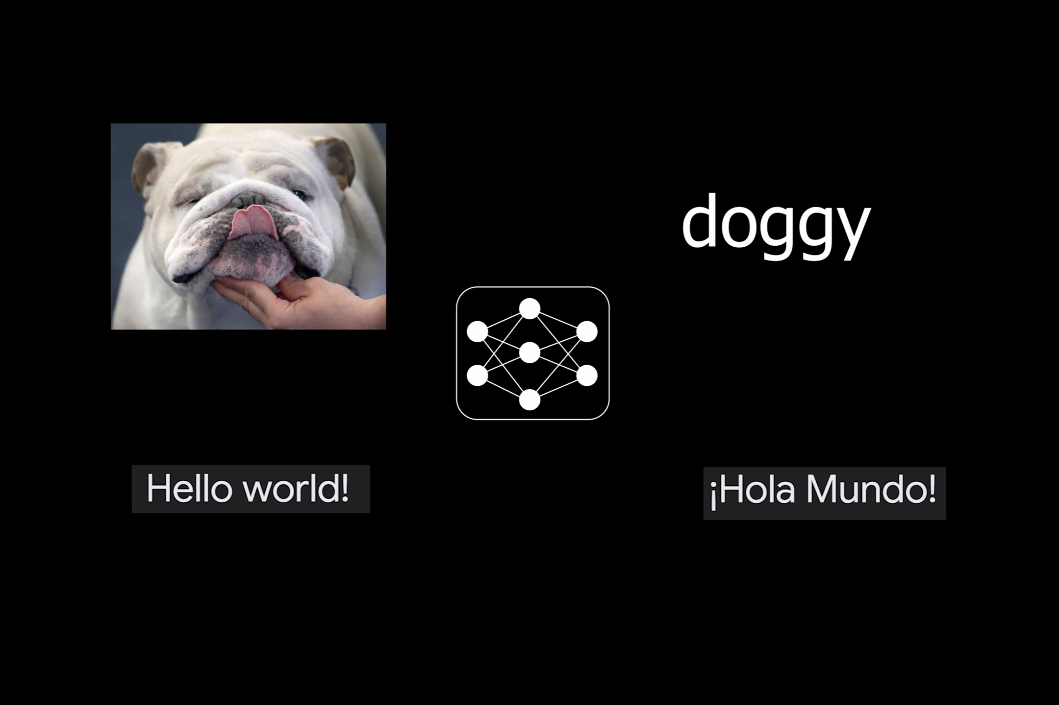

Slide 24
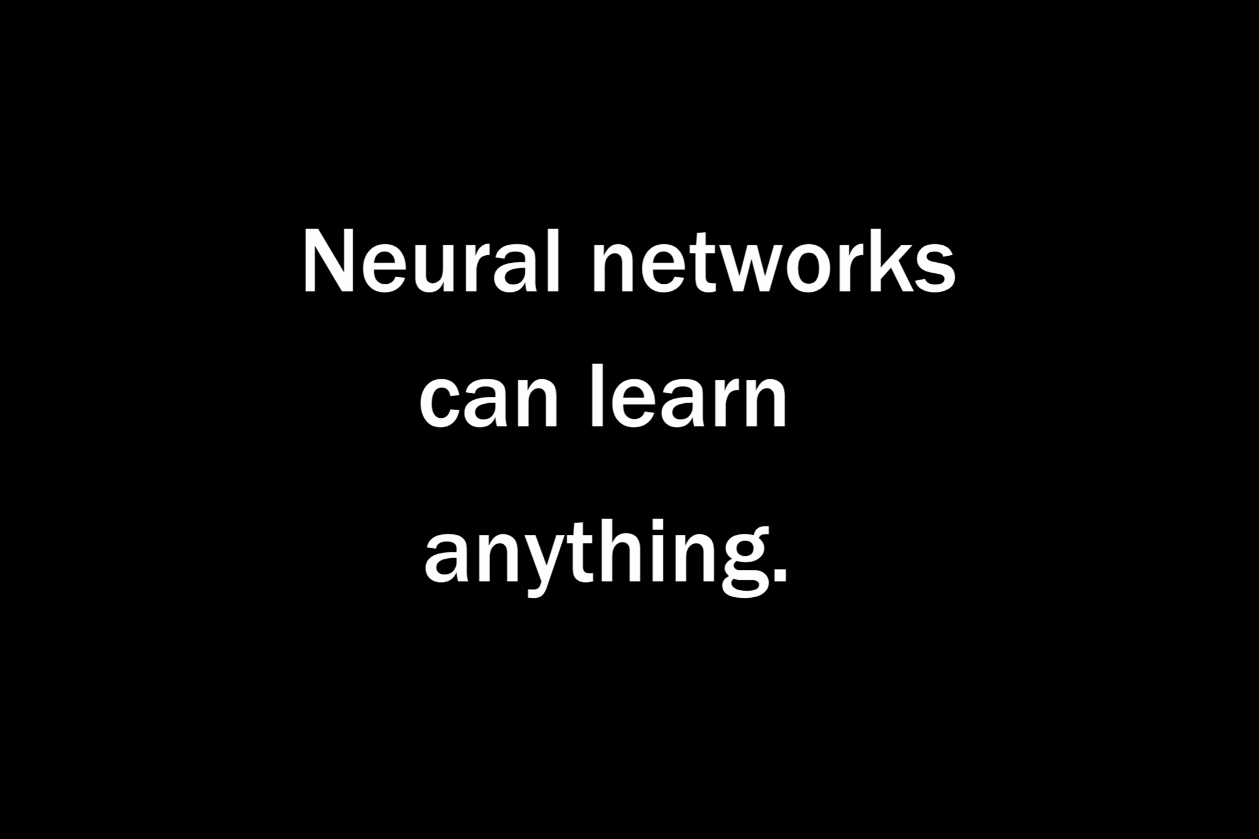

Slide 25
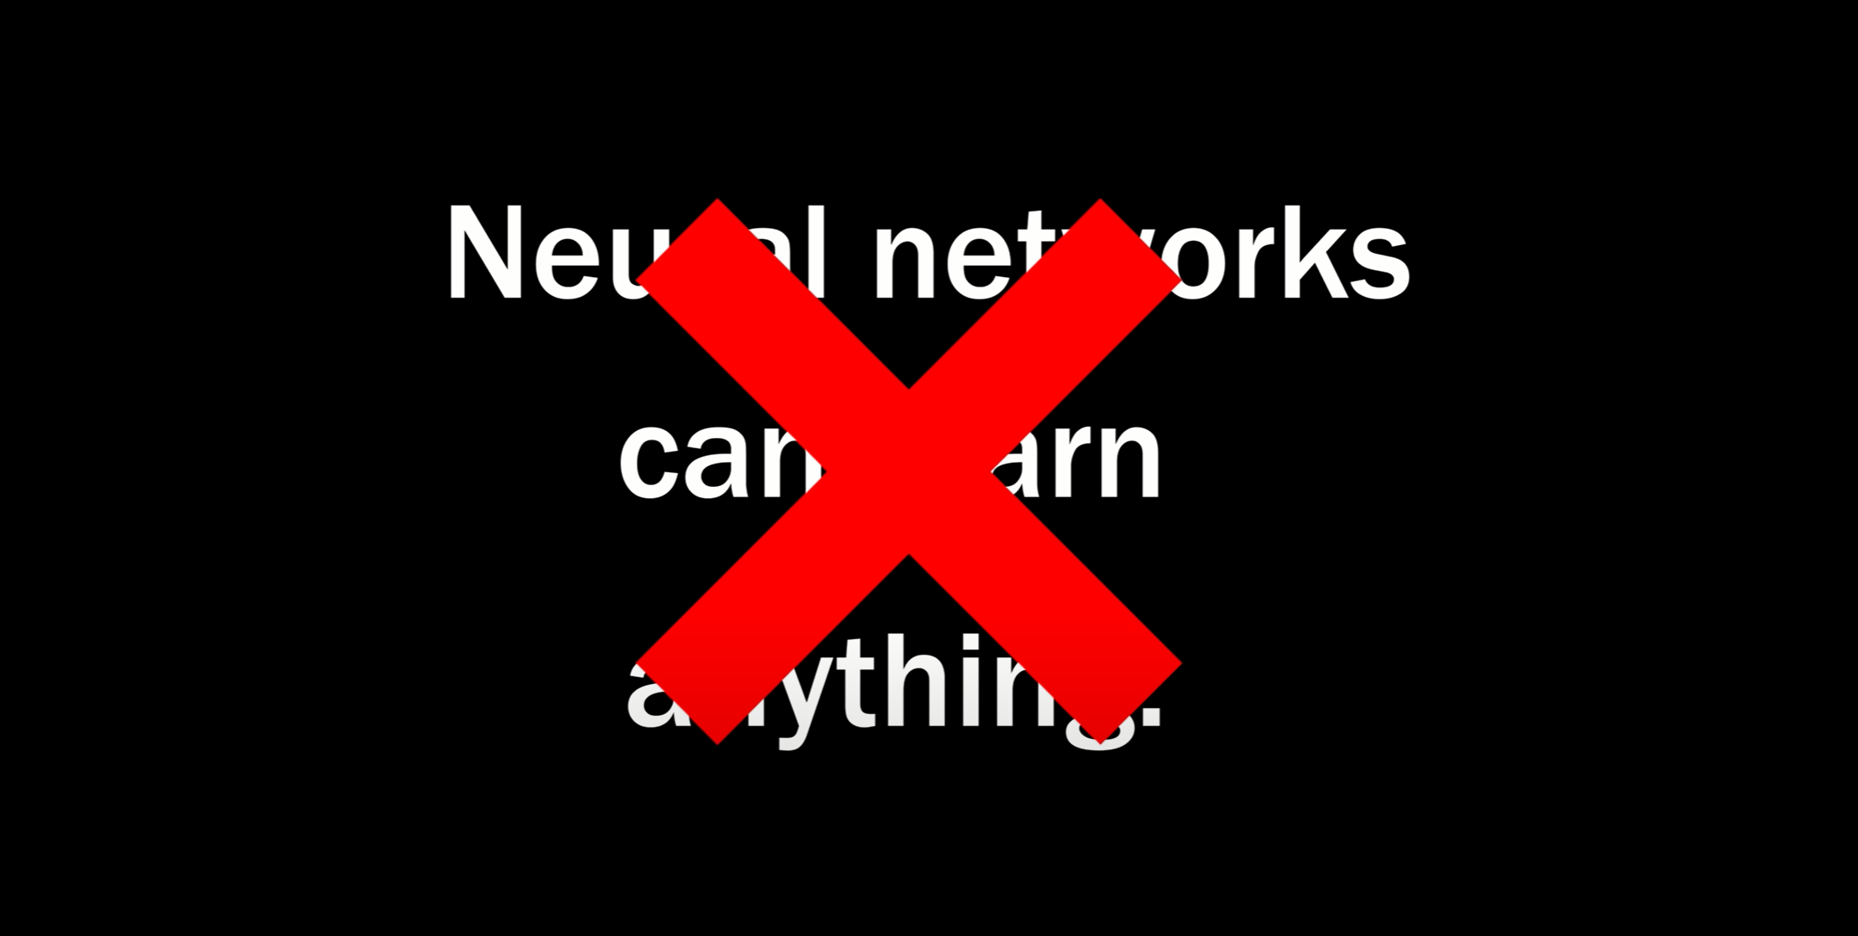

Slide 26
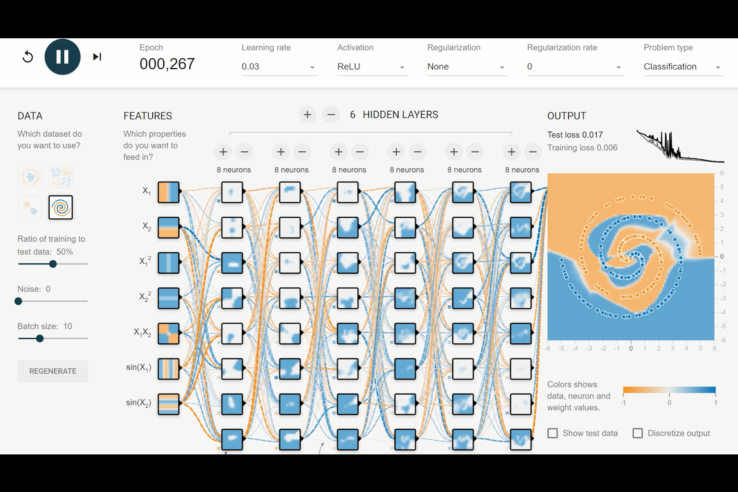

Slide 27
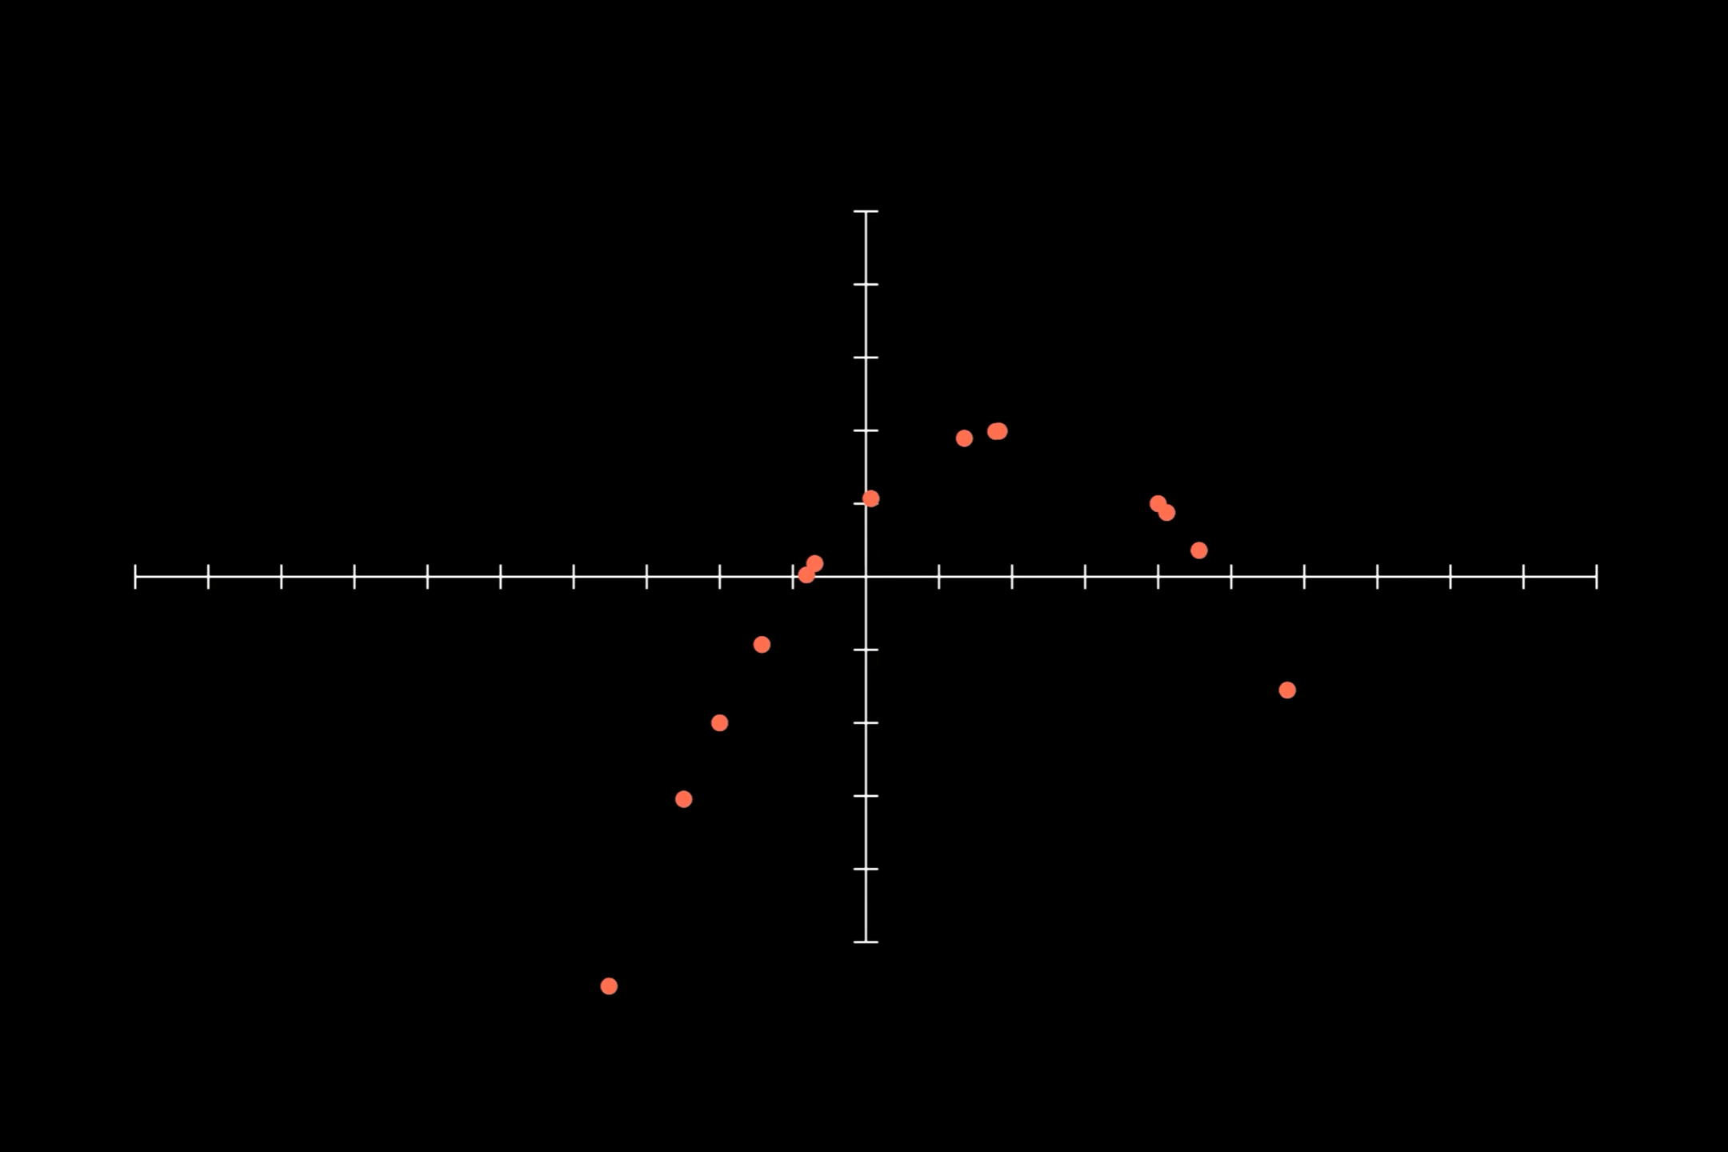

Slide 28
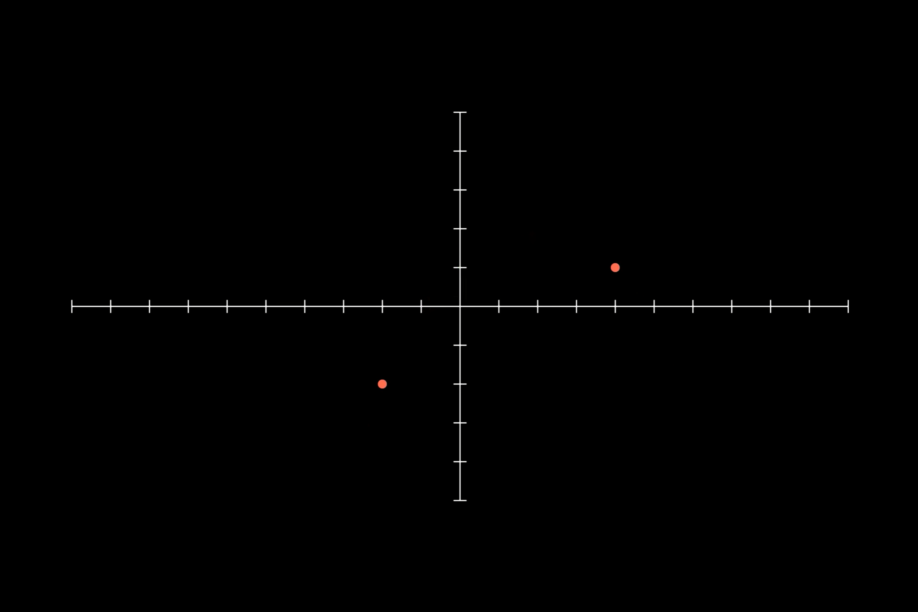

Slide 29
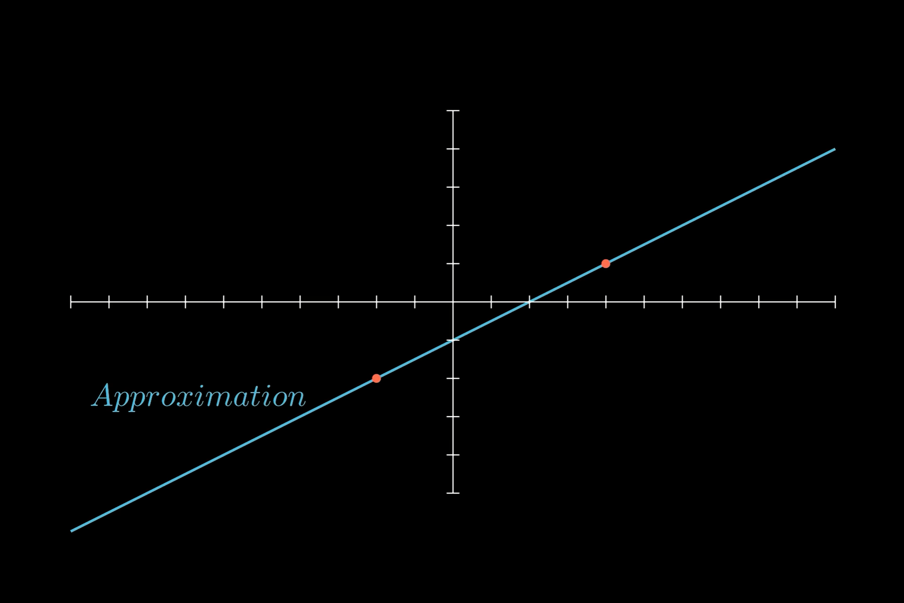

Slide 30
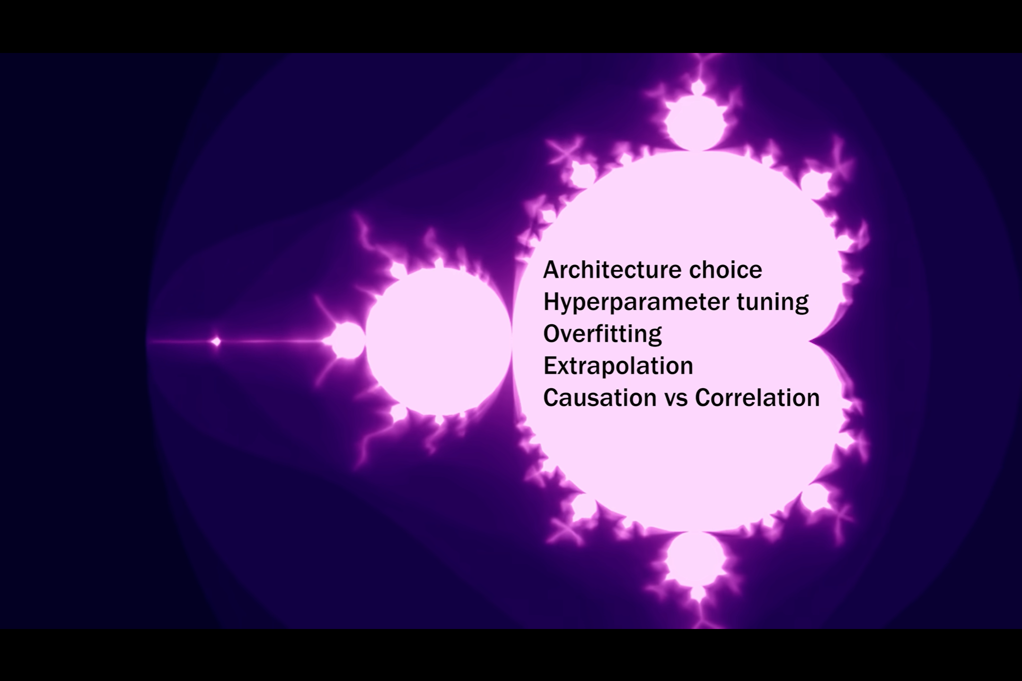

Slide 31
SOURCES Neural network playground: https://playground.tensorflow.org/ Universal Function Approximation:
Proof: https://cognitivemedium.com/magic_pap... Covering ReLUs: https://proceedings.neurips.cc/paper/... Covering discontinuous functions: https://arxiv.org/pdf/2012.03016.pdf Turing Completeness: Networks of infinite size are turing complete: Neural Computability I & II (behind a paywall unfourtunately, but is cited in following paper) RNNs are turing complete: https://binds.cs.umass.edu/papers/199... Transformers are turing complete: https://arxiv.org/abs/2103.05247 More on backpropagation: https://www.youtube.com/watch?v=Ilg3g... More on the mandelbrot set: https://www.youtube.com/watch?v=NGMRB... Additional Sources: Neat explanation of universal function approximation: https://www.youtube.com/watch?v=Ijqkc... Where I got the hard coded parameters: https://towardsdatascience.com/can-ne...

Slide 32
GRADIENT DESCENT

Slide 35
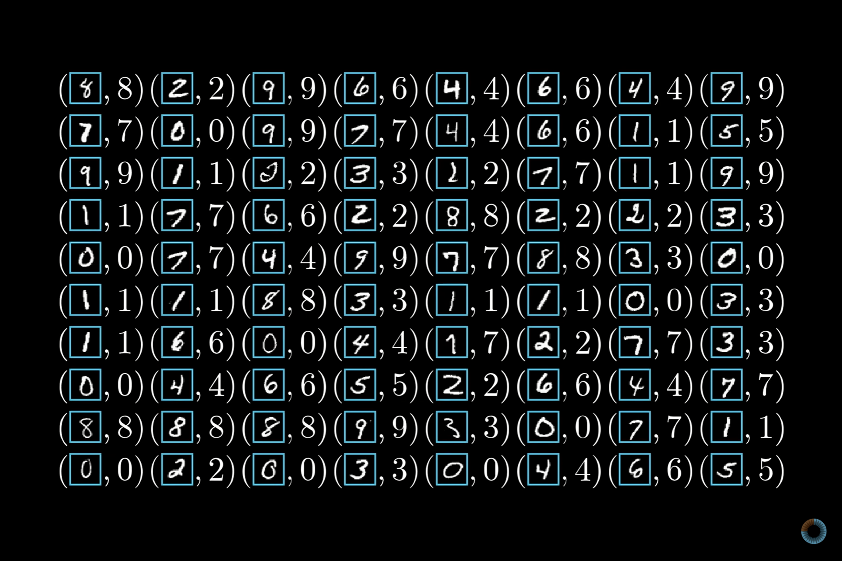

Slide 36
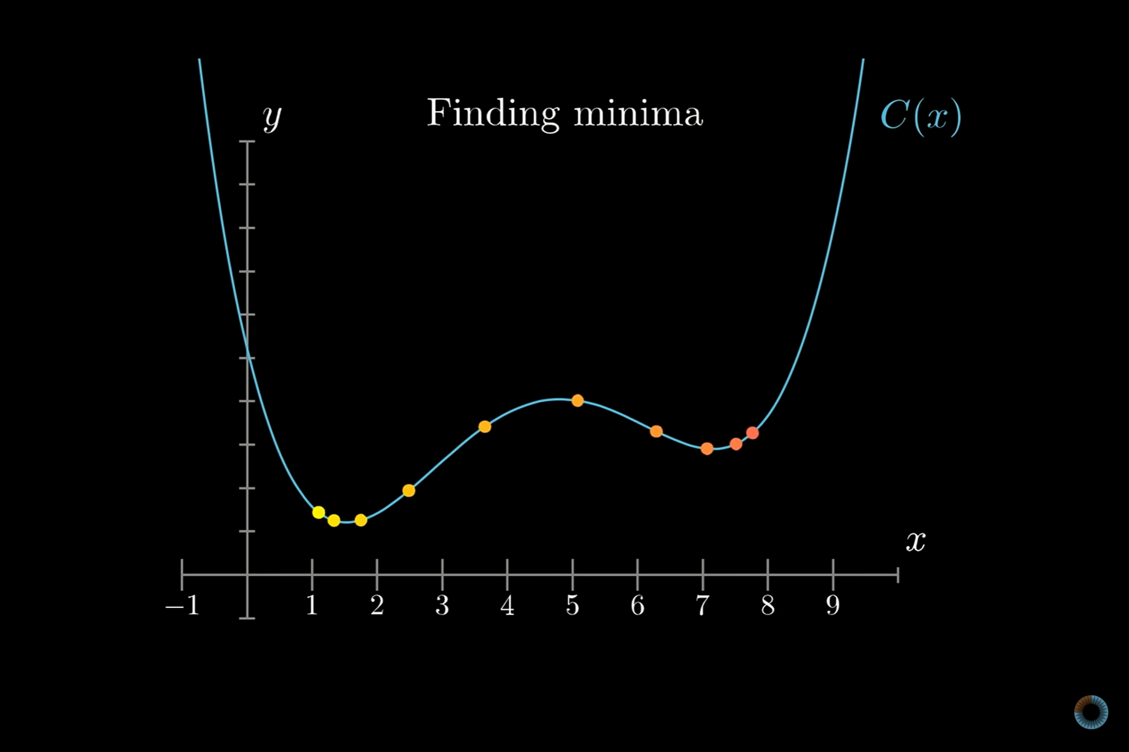

Slide 37
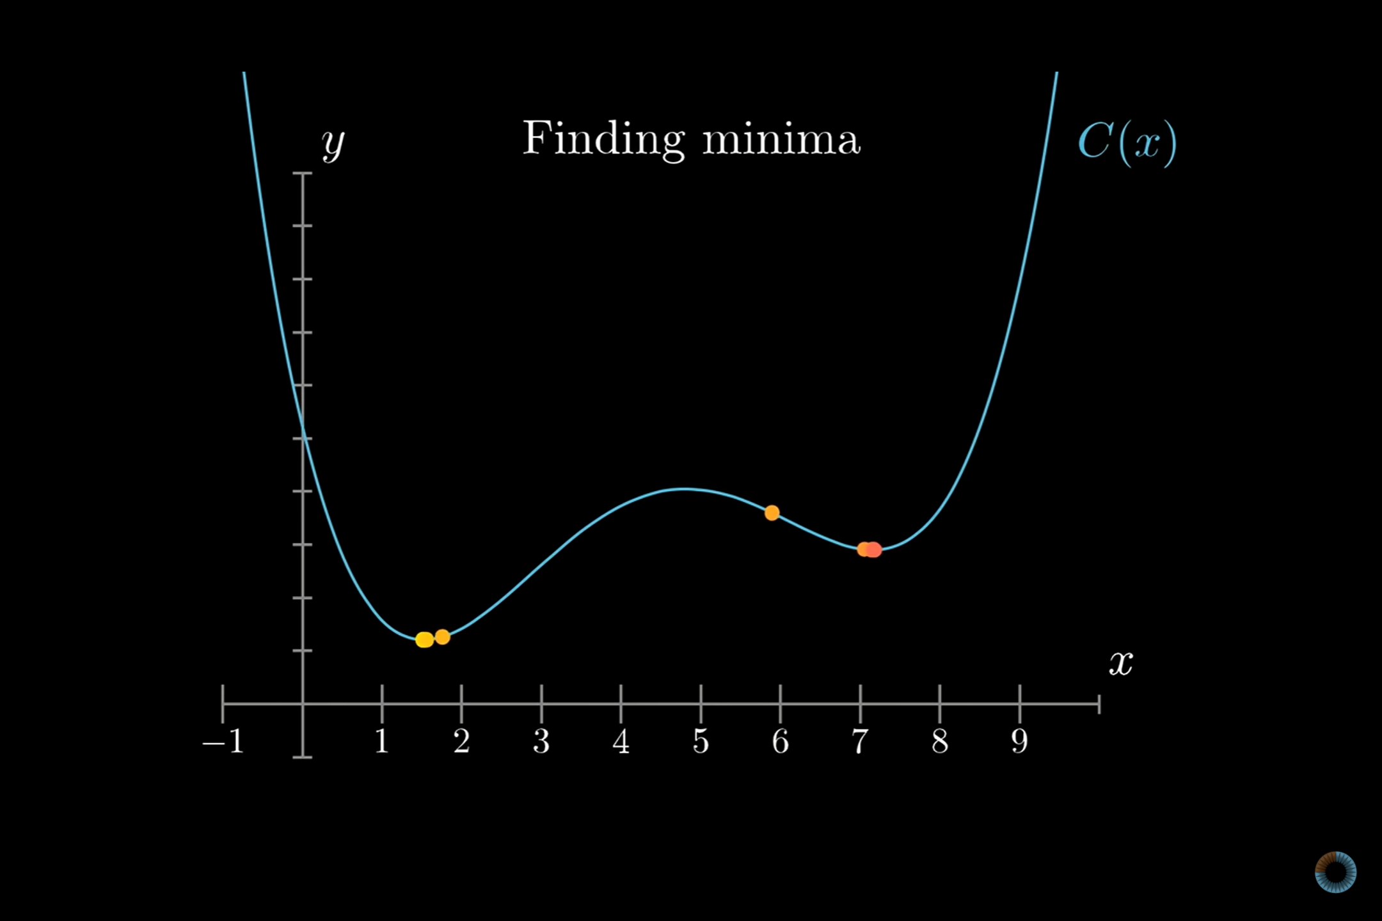

Slide 38
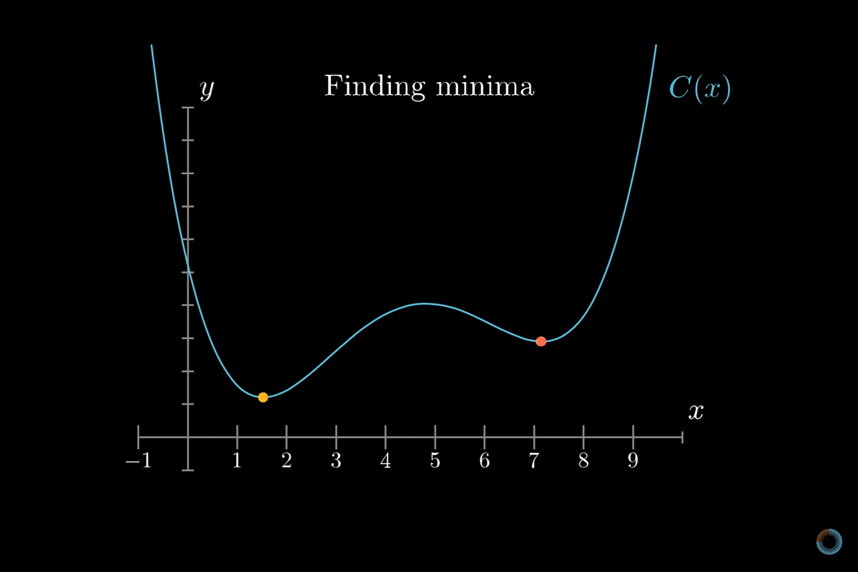

Slide 39
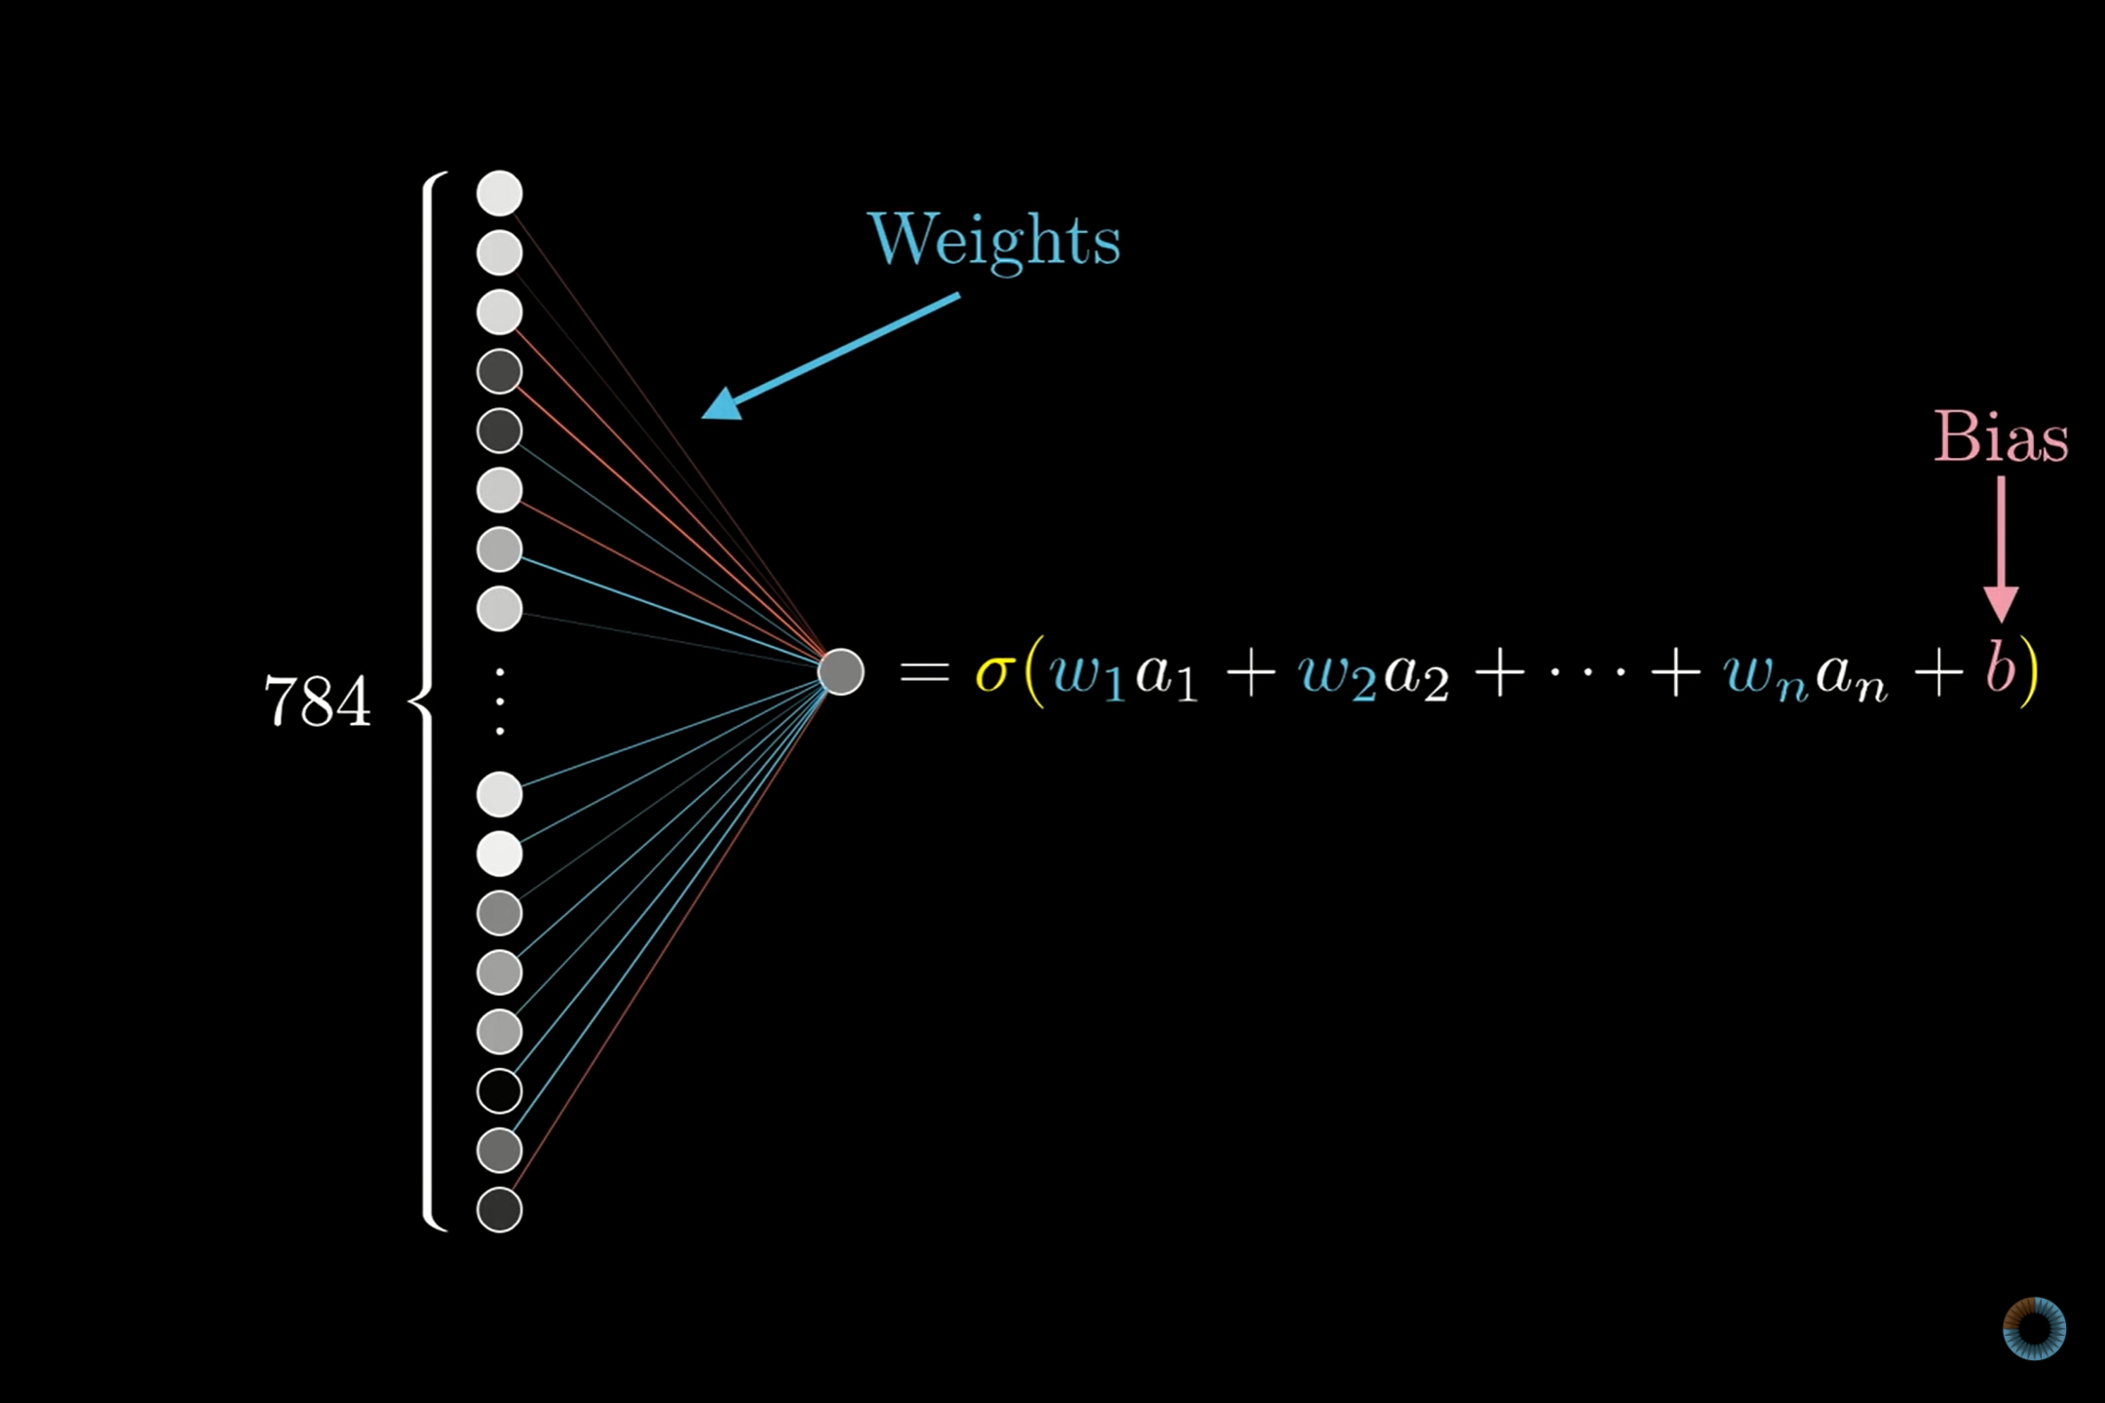

Slide 40
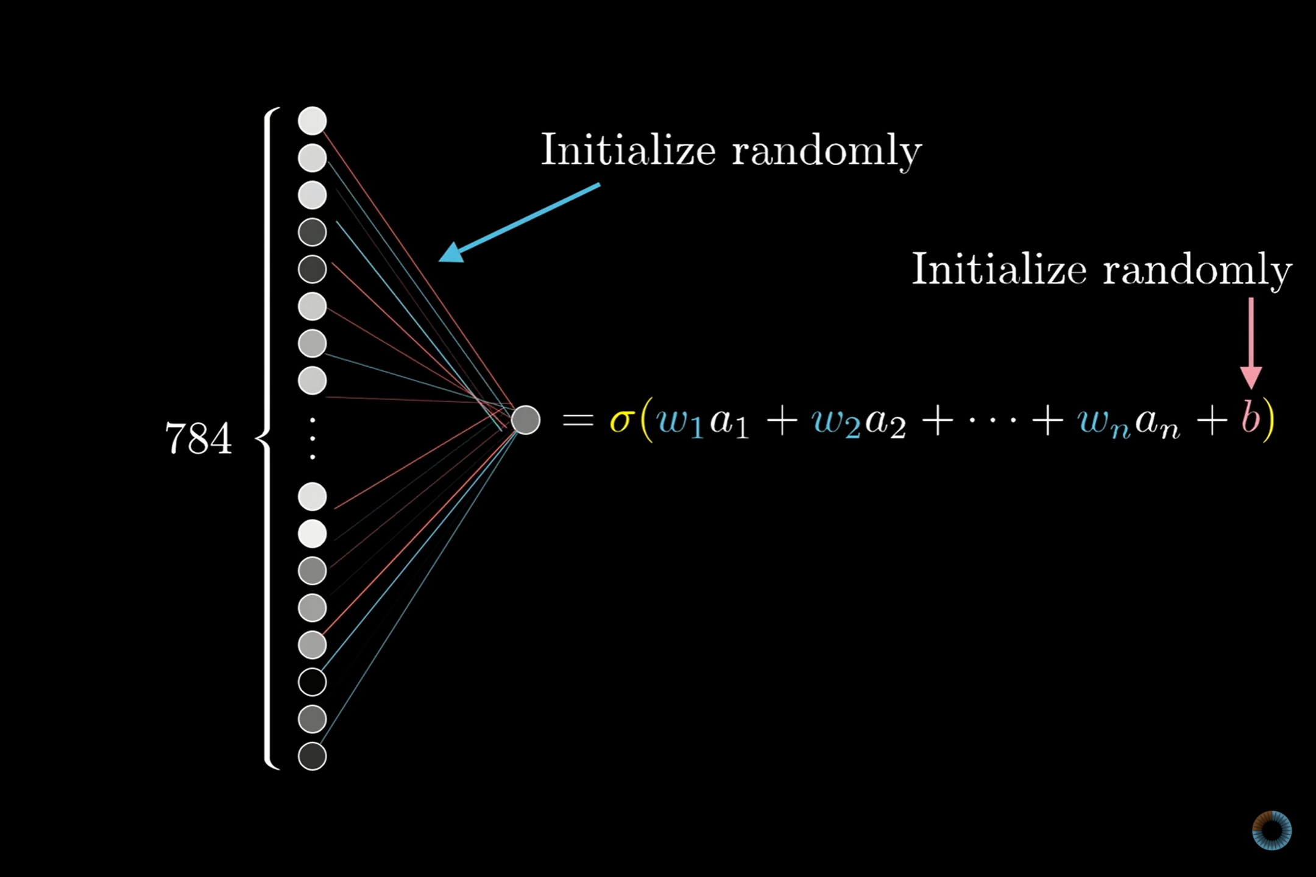

Slide 41
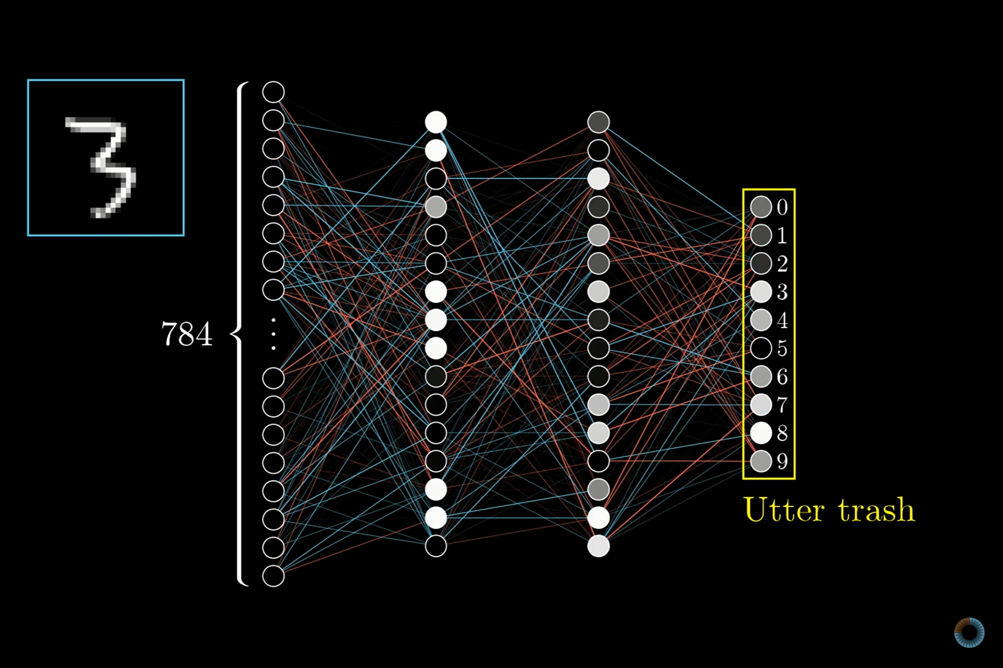

Slide 42
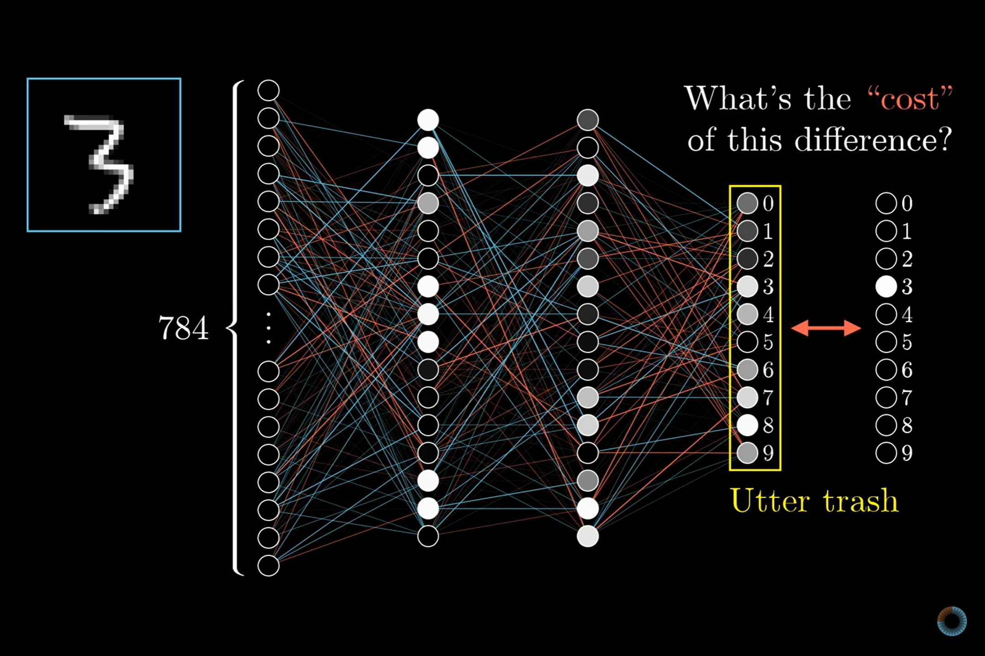

Slide 43
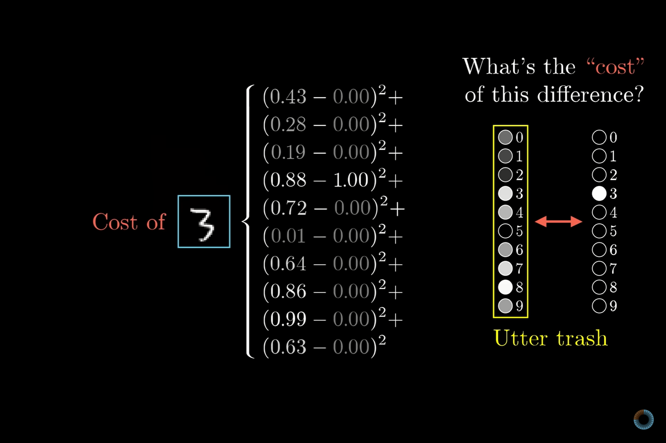

Slide 44
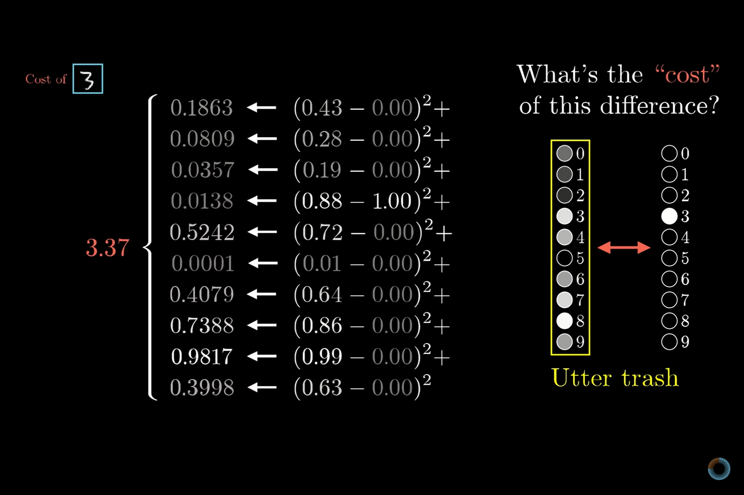

Slide 45
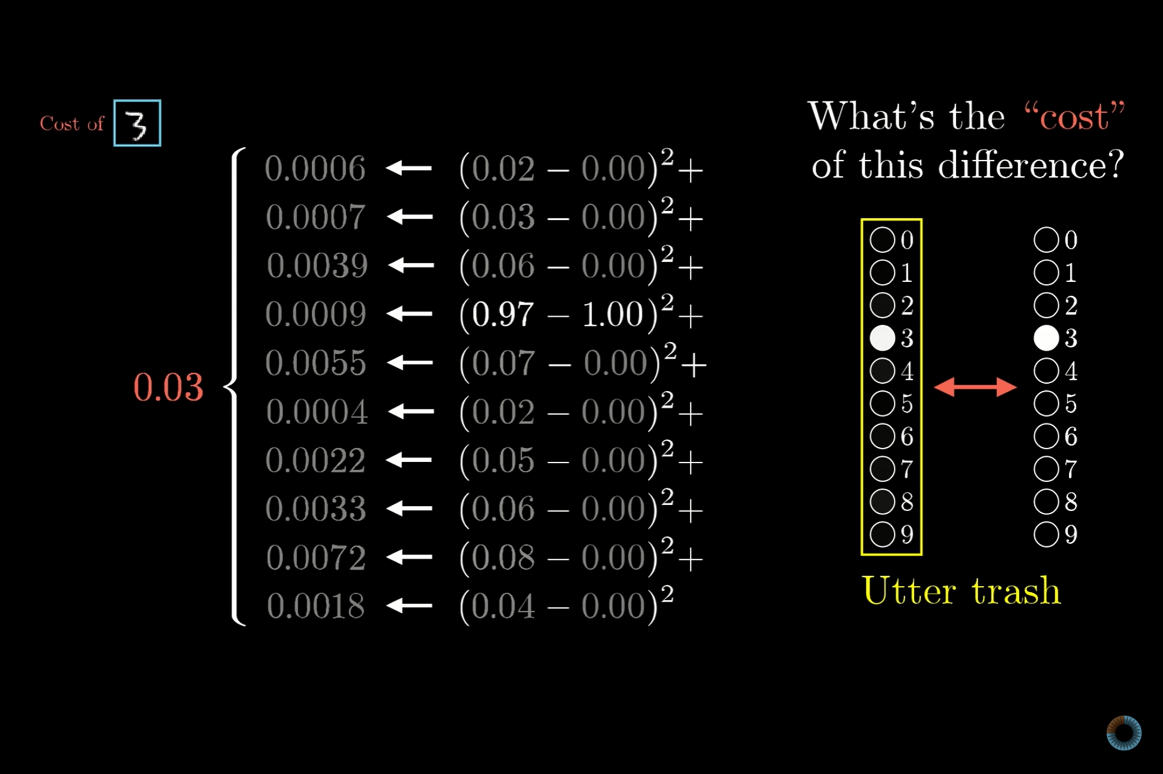

Slide 46
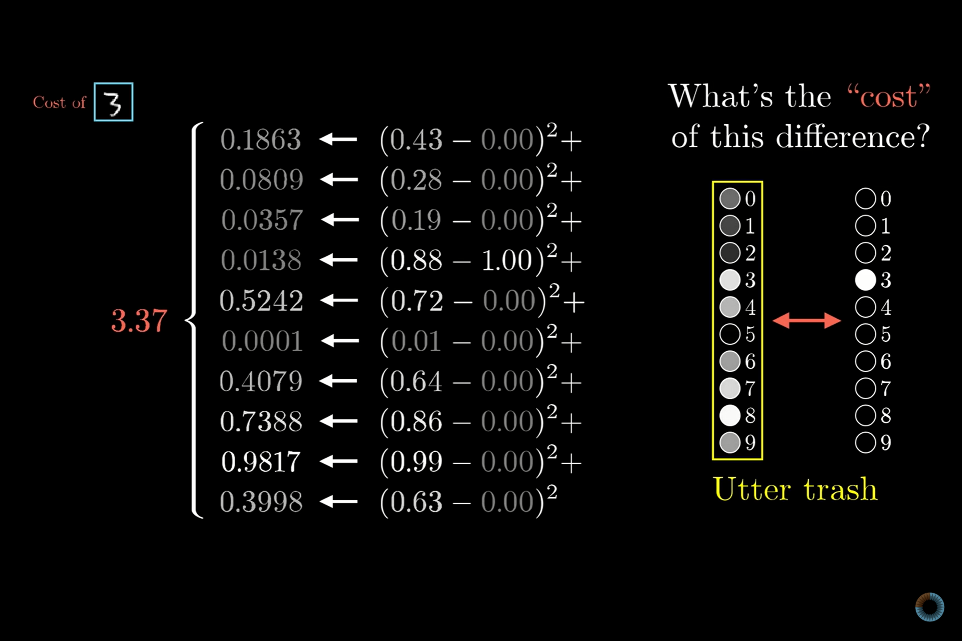

Slide 47
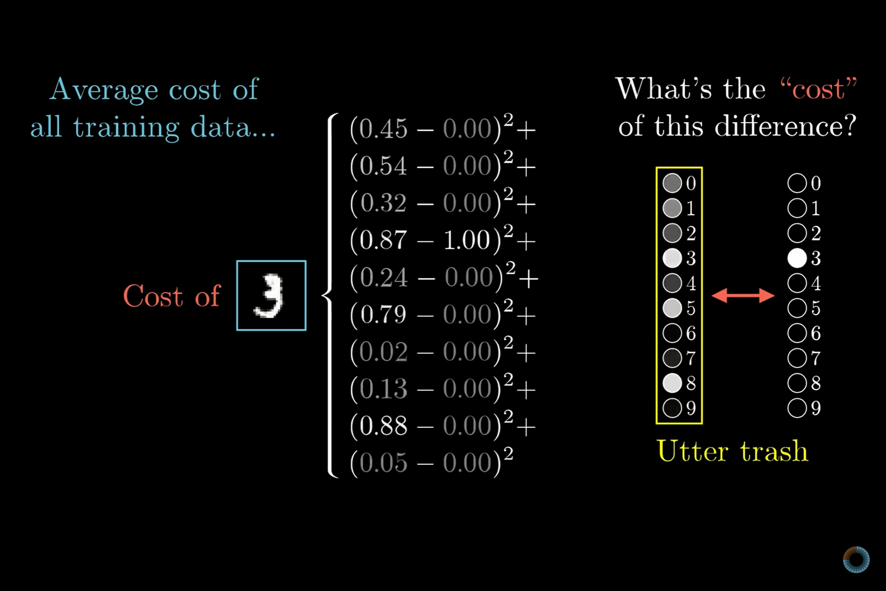

Slide 48
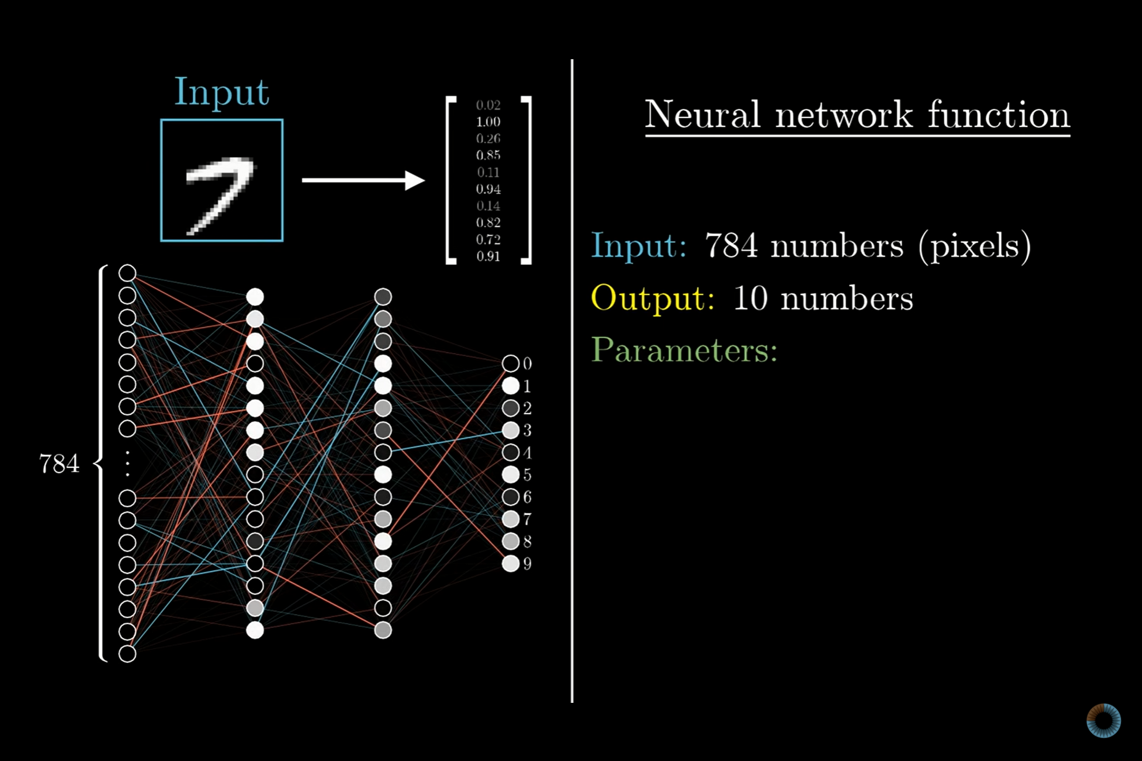

Slide 49
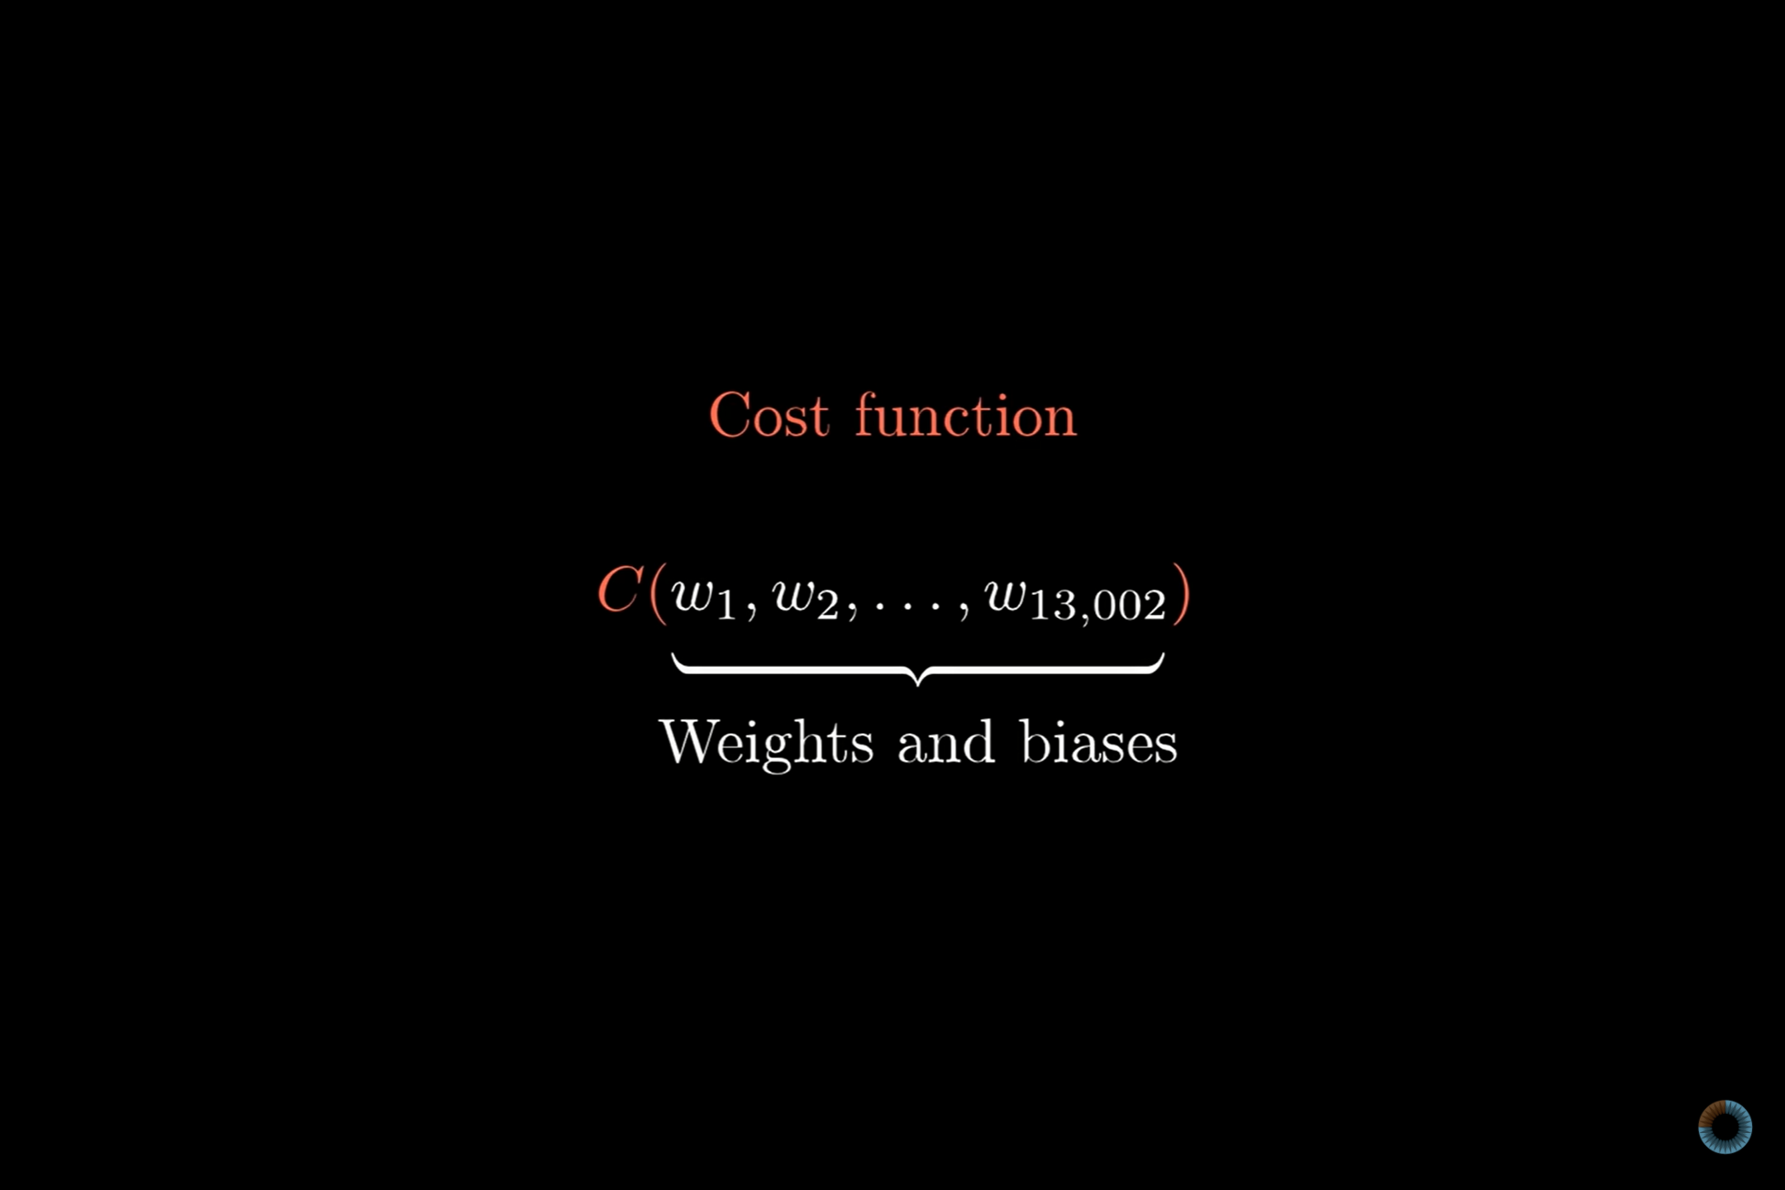

Slide 50
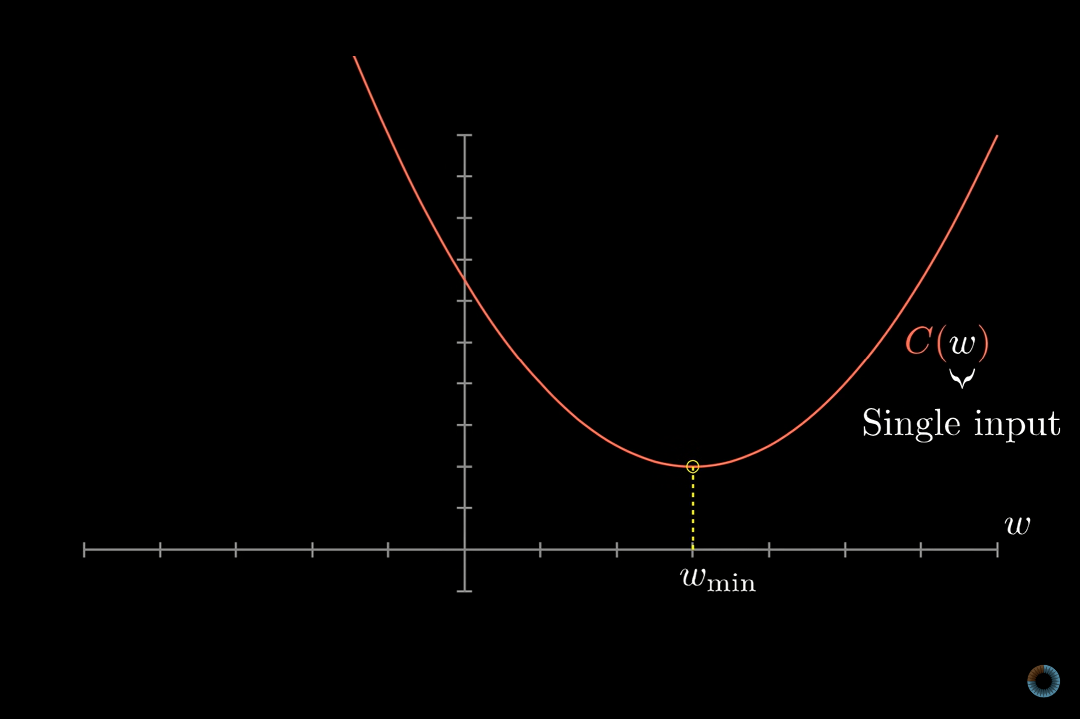

Slide 51
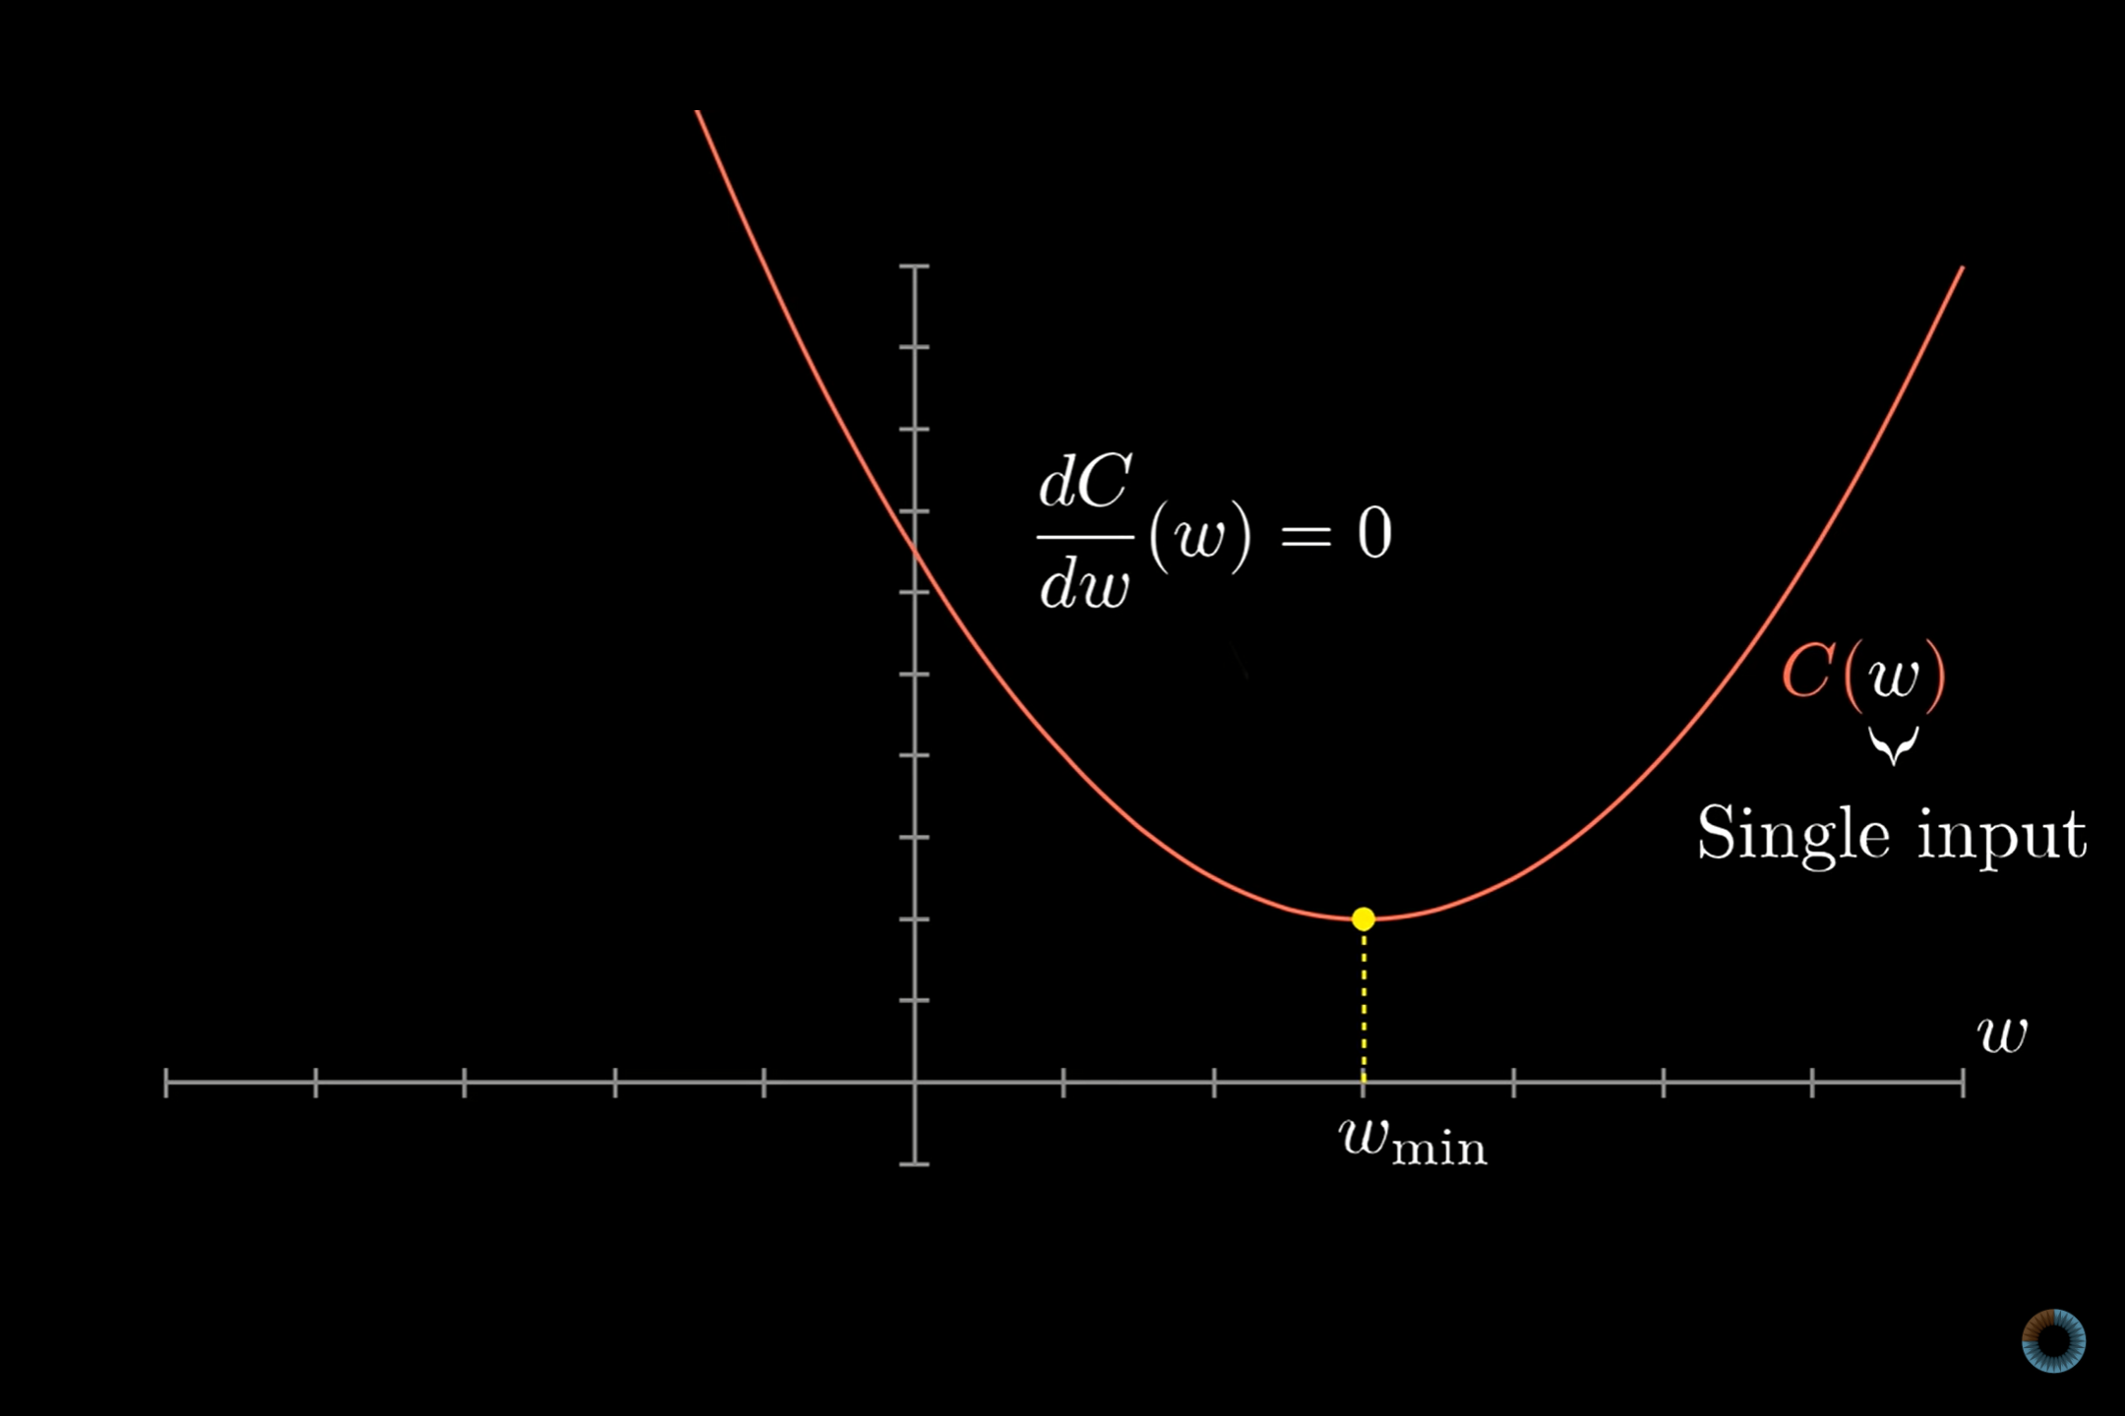

Slide 52
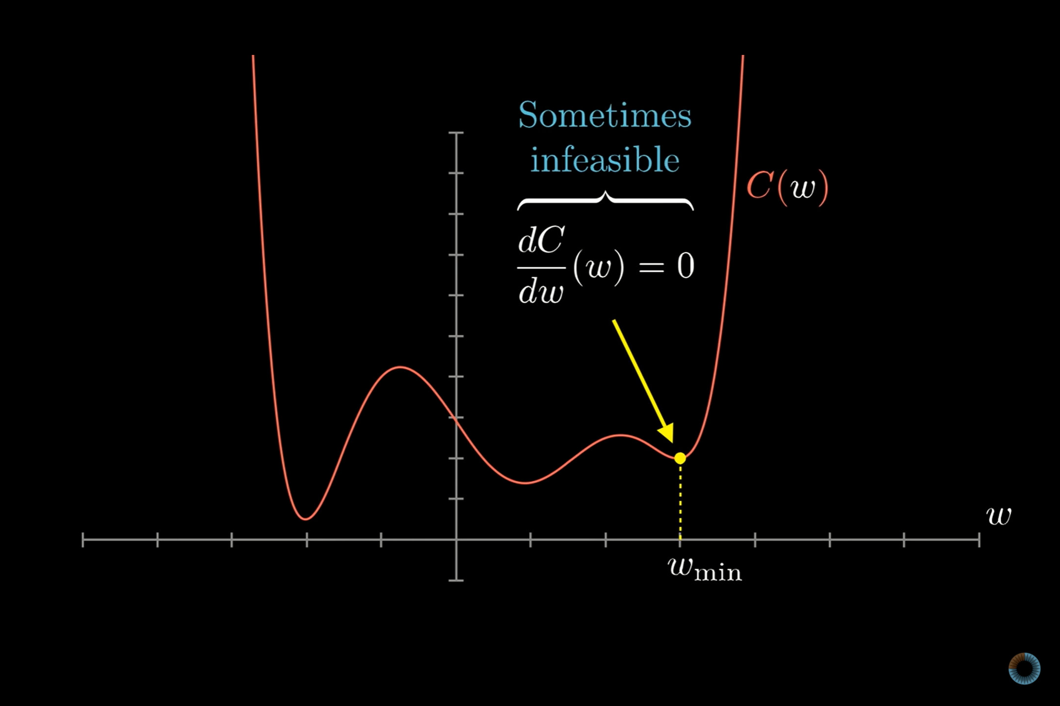

Slide 53
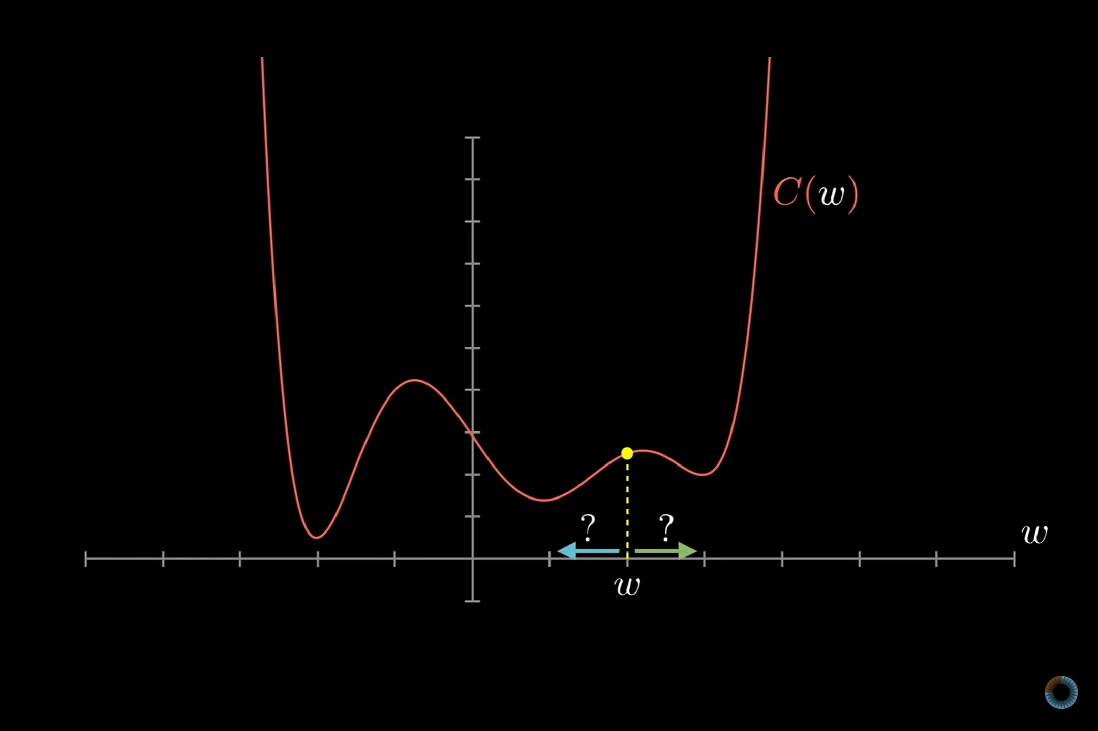

Slide 54
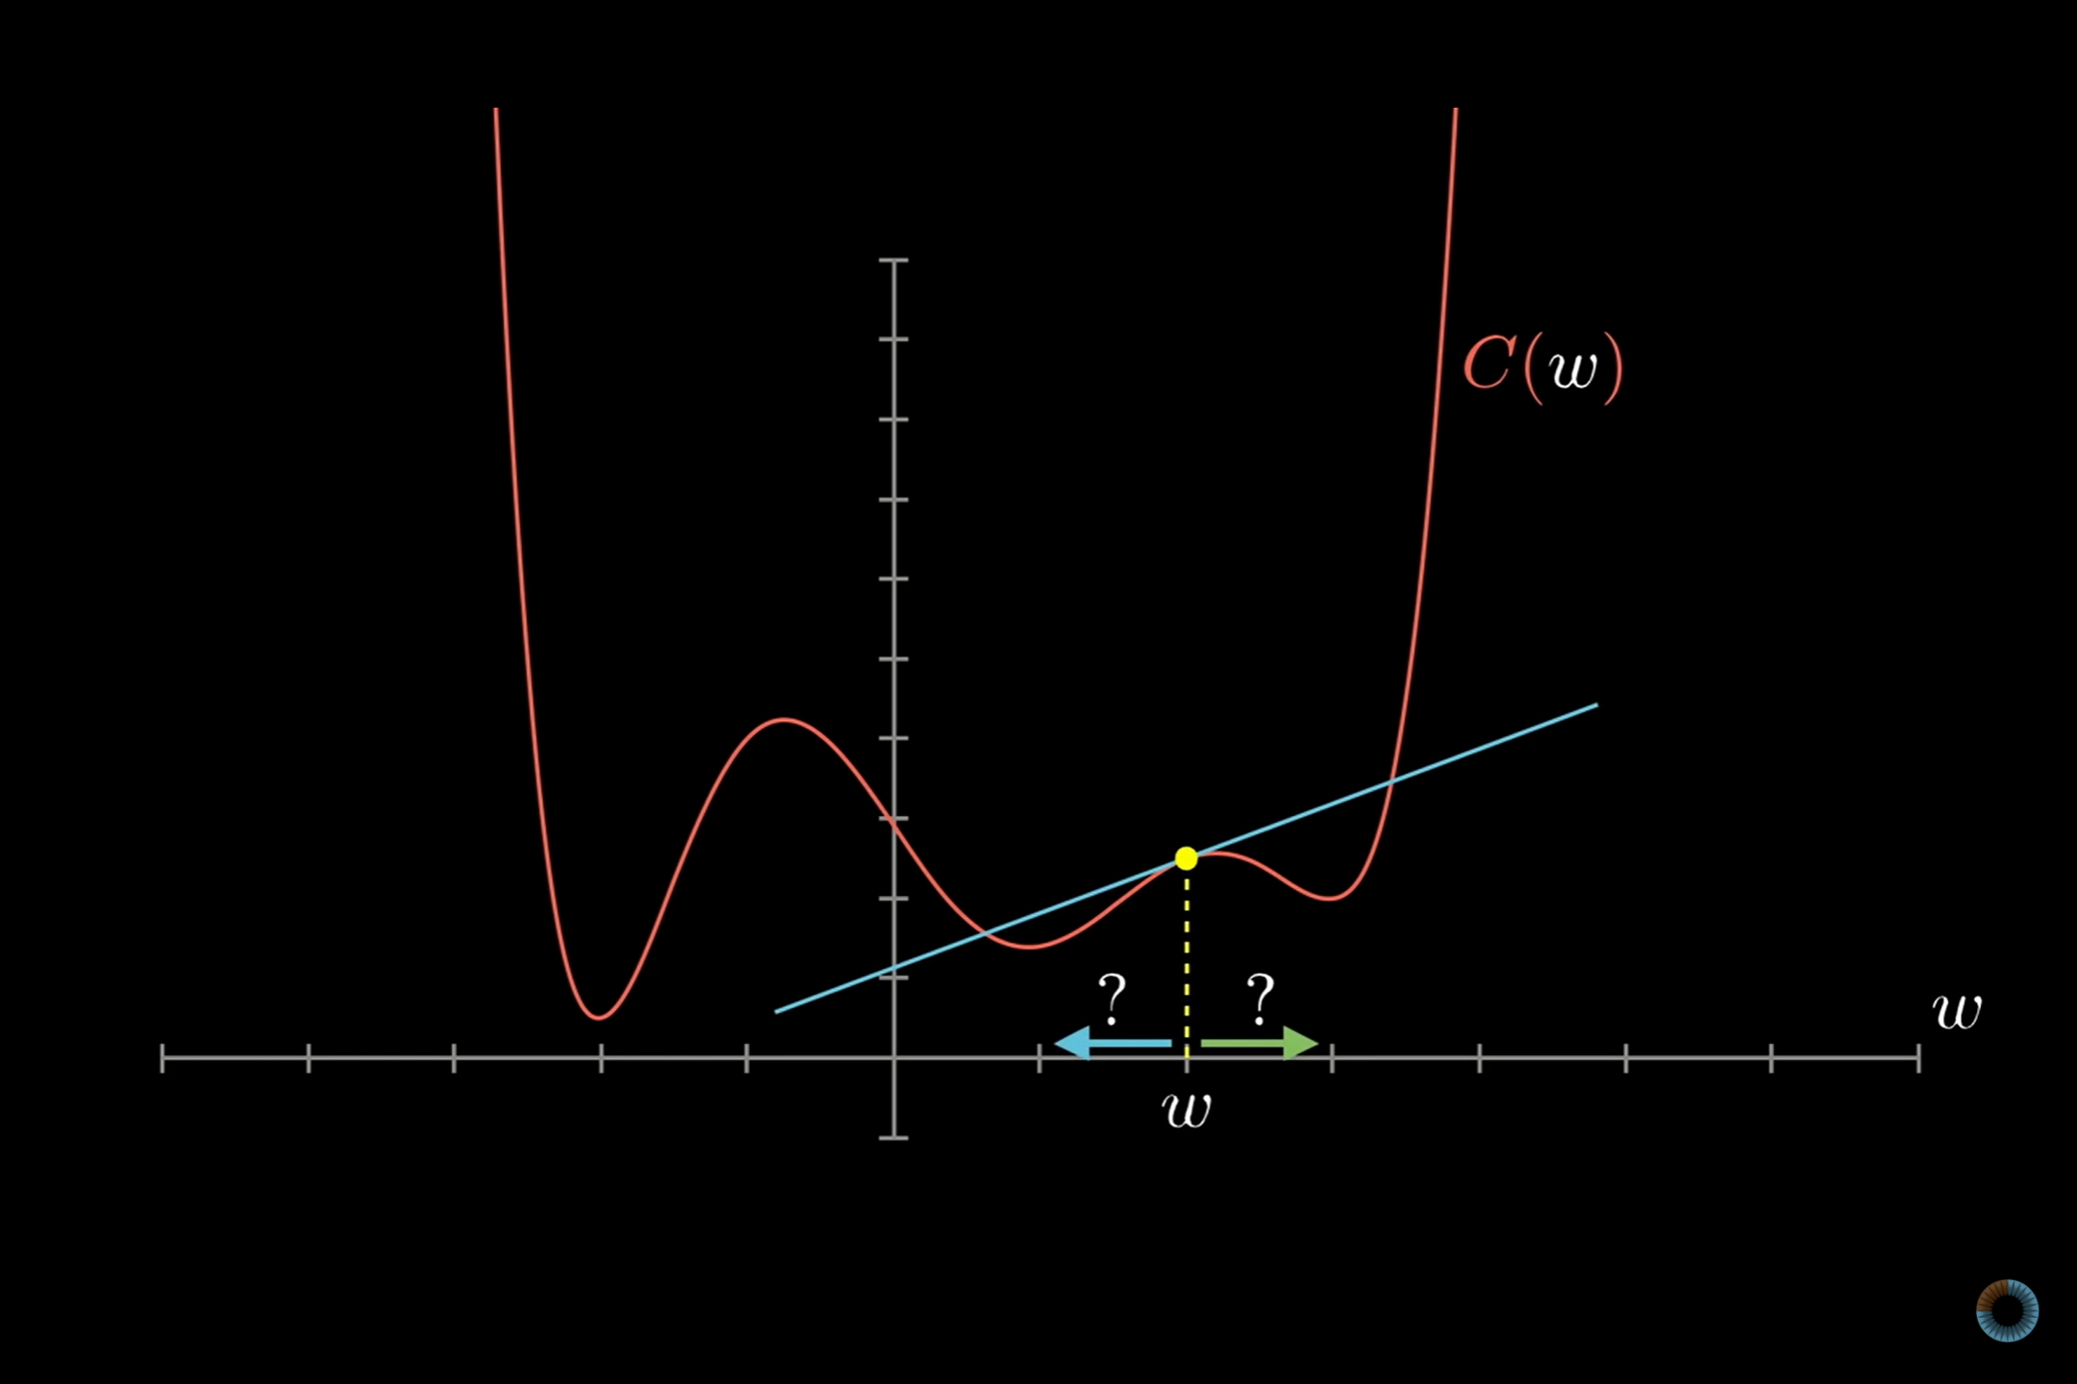

Slide 55
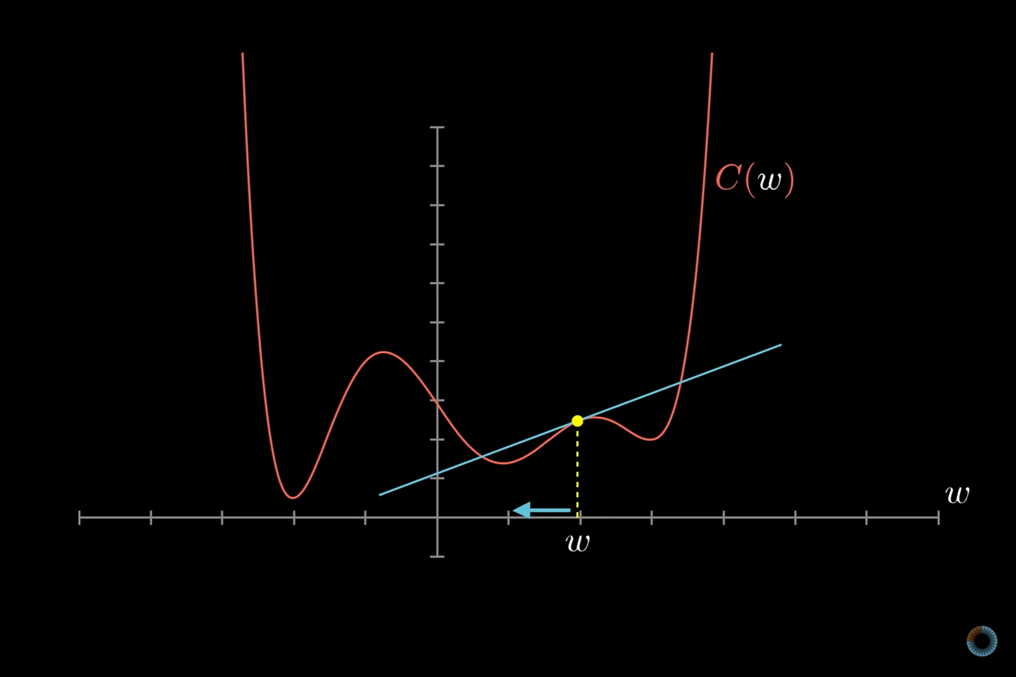

Slide 56


Slide 57


Slide 58


Slide 59


Slide 60


Slide 61


Slide 62


Slide 63
Machine Learning for Biomedical Data An introduction to Deep Learning
by Fernando Carazo, PhD

